Slide 1
52 Math Puzzles for 2 – 5
These puzzles have links to longer puzzle descriptions and solution notes.
The first few slides have examples of models of possible classroom slides.
Each slide has animated hints if you want to use them. These hints often have optional solution strategies that provide insights but are not needed for having fun with the puzzles.

Slide 2
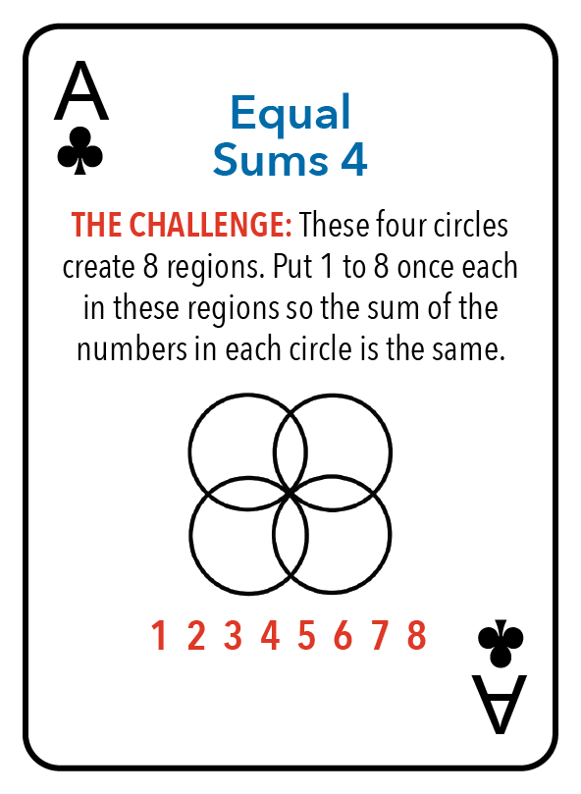
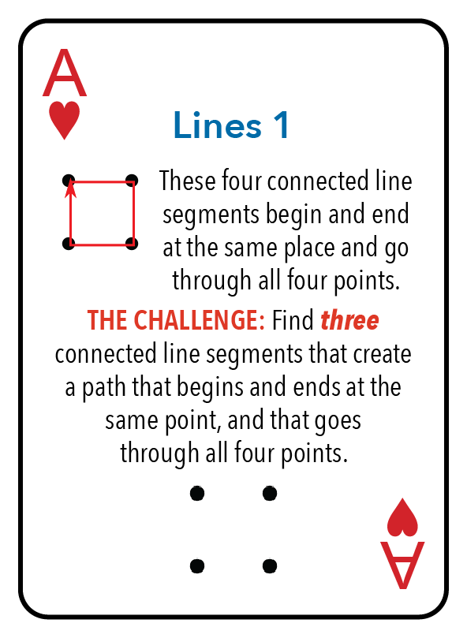
Example Slide 1
Choose
Your
Challenge
Puzzle – Ace Clubs
Puzzle – Ace Hearts

Slide 3
Example Slide 2
What is your strategy?
For these types of puzzles, it often helps to add up all the regions with the same sum. What happens if you add up the four circles?
Puzzle – Ace Clubs

Slide 4
Hints:
The contents of each circle add up to the same thing. Look at adding up all four circles.
Four of the circle sums will be the sum of all the numbers (36) plus the four overlap regions. So a circle sum is one fourth of that, which is 9 plus a fourth of the overlaps.
The smallest sum for the overlaps is 1+2+3+4 = 10, and the largest is 5+6+7+8 = 26. The overlap sum must be evenly divisible by four, so it is 12, 16, 20, or 24. Thus, the circle sums must be 9 plus one fourth of that, which is 9+3, 9+4, 9+5, or 9+6, which narrows the possibilities a lot!
Puzzle – Ace Clubs
Notes:
Hints:
Look for very large or very small numbers – they may only have one choice.
Start with 7 and 0. They must go together.
That determines two pairs next to the 7 and 0. The 2 and 5 go together, and the 4 and 3 go together.

Slide 5
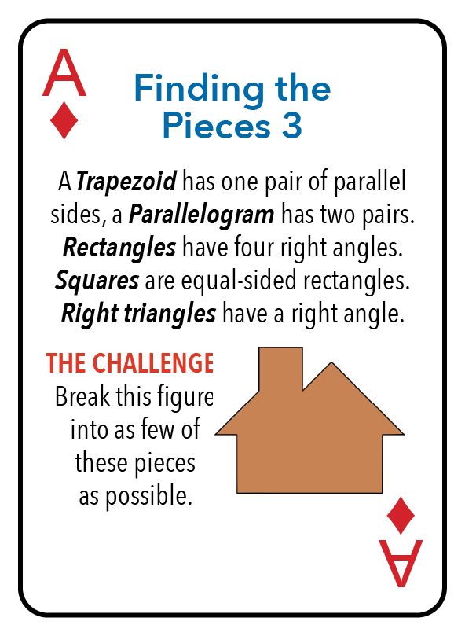
Hints:
The bottom half of the figure will be a rectangle.
The chimney will be a square.
You have at least two choices for what to do with the rest of the picture.
Puzzle – Ace Diamonds

Slide 6
Hints:
Don’t restrict yourself to line segments that stay within the square of four points.
There are solutions that begin and end at one of the four points, and there are solutions where none of the lines begin or end at one of those points.
Puzzle – Ace Hearts

Slide 7
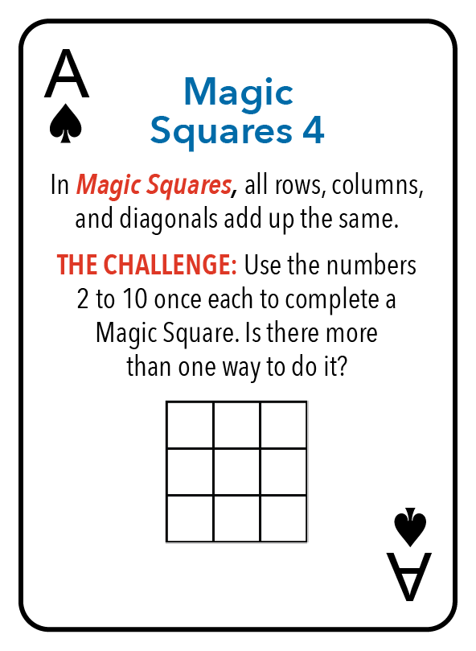
Hints:
Calculate what the common sum will be.
The three rows involve all nine numbers, so their sum is 54. Therefore, a row (or column or diagonal) adds up to 54 / 3 = 18.
Add up the four lines that go through the center and discover what the value of the center must be.
The center must be 6.
Look at the various ways of adding up to a total of 18 using three of the numbers from 2 through 10. Some numbers are only involved in two ways, and others in three ways.
Puzzle – Ace Spades

Slide 8
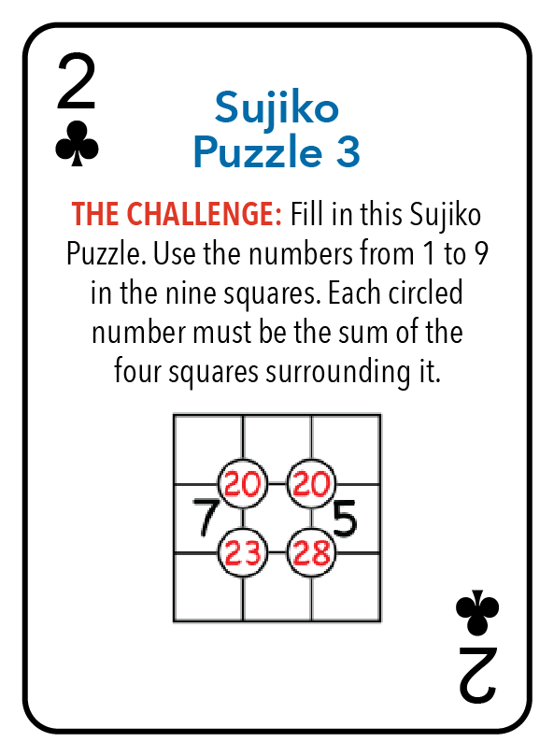
Hints:
Look at the circle with the biggest sum - 28.
The only way to get 28 using 5 and not using 7 is 5+6+8+9.
Look at the upper right 2 by 2 square. The largest values in the upper two squares there are 3 and 4. Therefore, the central square between the 7 and 5 must be 8 or 9.
Consider the two cases for 8 or 9 being in the center, and see which one works.
Puzzle – 2 Clubs

Slide 9
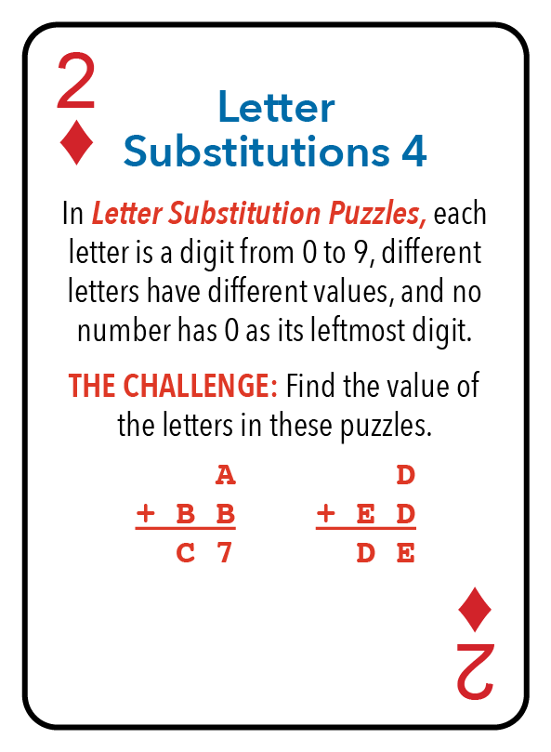
Hints:
A + B causes a carry into the tens column, so A + B = 17.
D + D causes a carry, and D is one more than E. Consider the possibilities for D + D = 1E.
Puzzle – 2 Diamonds

Slide 10
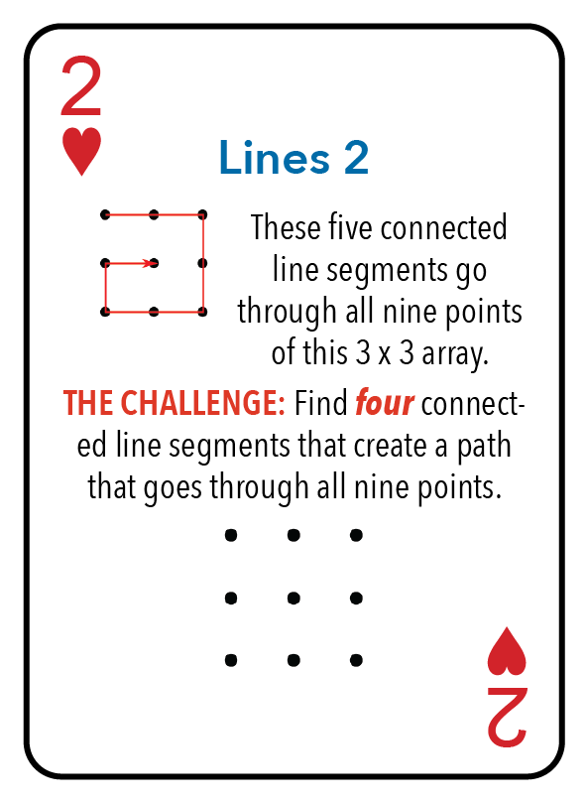
Hints:
Apply what you learned from doing “Lines 1” on the Ace of Hearts.
Puzzle – 2 Hearts

Slide 11
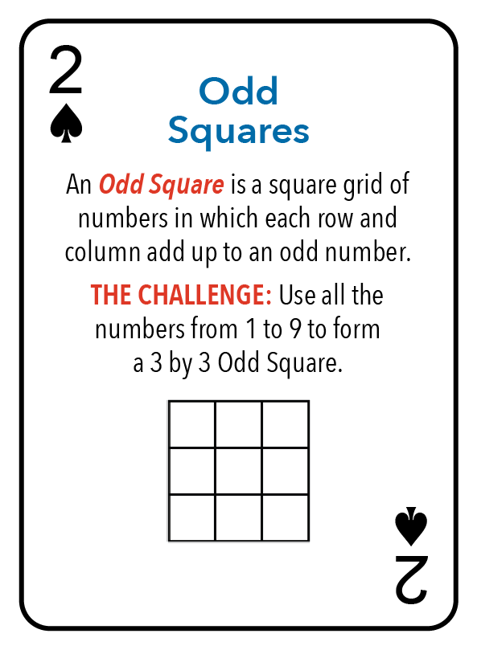
Hints:
The only thing that is important about each number in this problem is whether it is even or odd. So, replace the numbers by 4 E’s (for Evens) and 5 O’s (for Odds).
The only way for a line to add up to an odd number is if there are one or three odd numbers.
There must be two rows (and columns) with one odd number and one row (and column) with three odd numbers. It doesn’t matter, so assume three odd numbers are in the top row and in the rightmost column.
There are a lot of solutions.
Puzzle – 2 Spades

Slide 12
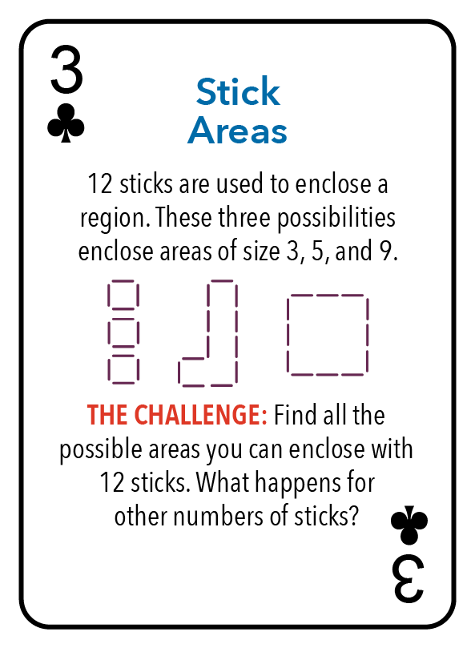
Hints:
Every possibility from 3 to 9 can occur.
Puzzle – 3 Clubs

Slide 13
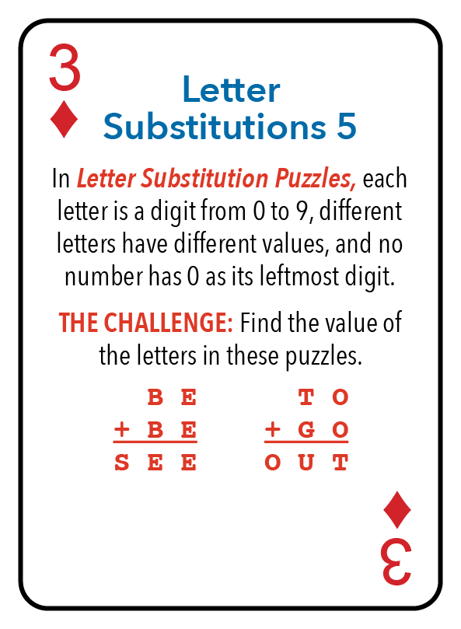
Hints:
E + E ends in E, so E must be 0.
B + B must be 10.
The largest possible carry is 1, so O is 1 and T is 2.
2 + G = 1U, and U cannot be 0.
Puzzle – 3 Diamonds

Slide 14
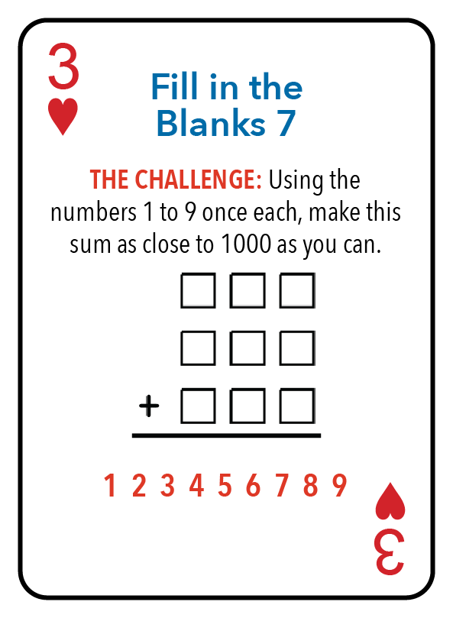
Hints:
You only need to decide which column a digit will be in. For example, having 123 + 456 + 789 is the same as having 159 + 423 + 786.
The carry into the hundreds column can only be 0, 1, or 2. So we want the hundreds column to add up to 8 or 9. Consider those two cases.
The numbers from 1 to 9 add up to 45. If the hundreds column adds up to 8, the remaining numbers add up to 37. If the hundreds column adds up to 9, the remaining numbers add up to 36.
If you use “casting out 9’s,” the sum of these three numbers must be evenly divisible by 9. So we are aiming for 999 or 1008, with 990 or 1017 being close seconds.
Puzzle – 3 Hearts

Slide 15
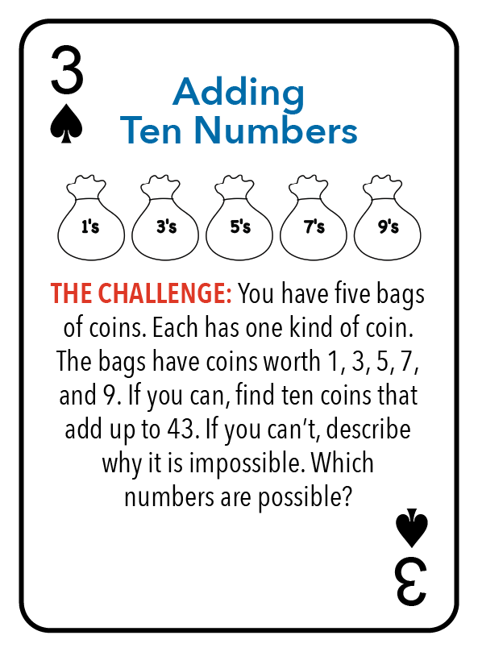
Hints:
What happens when you add up two odd numbers? How about four odd numbers?
Ten odd numbers will add up to an even number, so 43 is impossible.
The smallest these can add up to uses all 1’s, and the largest uses all 9’s.
Starting at 10 x 1, we can increase the sum by 2 at a time all the way up to 90 by replacing an odd number with the next odd number.
Puzzle – 3 Spades

Slide 16
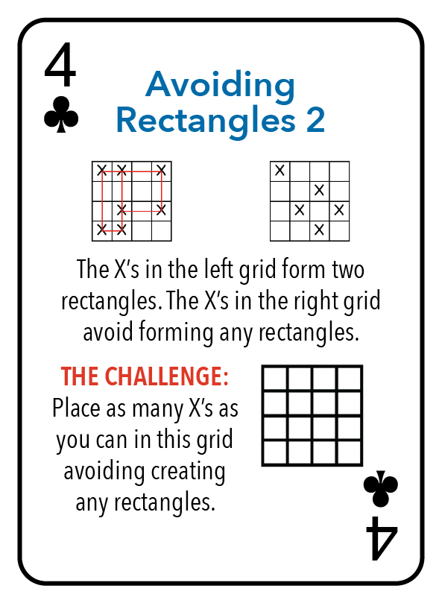
Hints:
Learn from doing an easier version of the puzzle.
An answer for the 3 by 3 grid looks like:
X X _
X _ X
_ X X
What would this look like for a 4 by 4?
Try filling the left column and the bottom row - except leave the bottom left corner empty. What would be a good way to finish this?
Puzzle – 4 Clubs

Slide 17
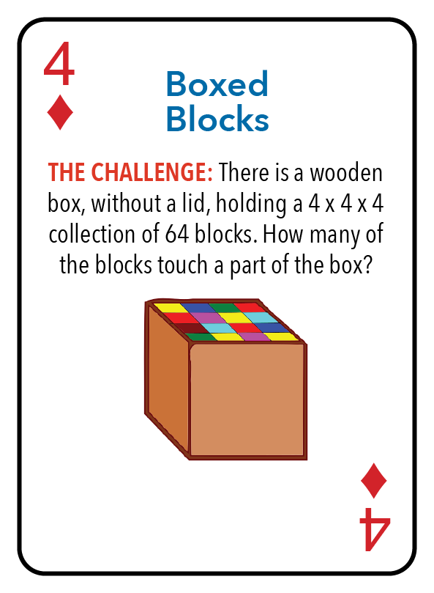
Hints:
How many blocks don’t touch any side of the box?
How can you use that answer to answer the puzzle?
Puzzle – 4 Diamonds

Slide 18
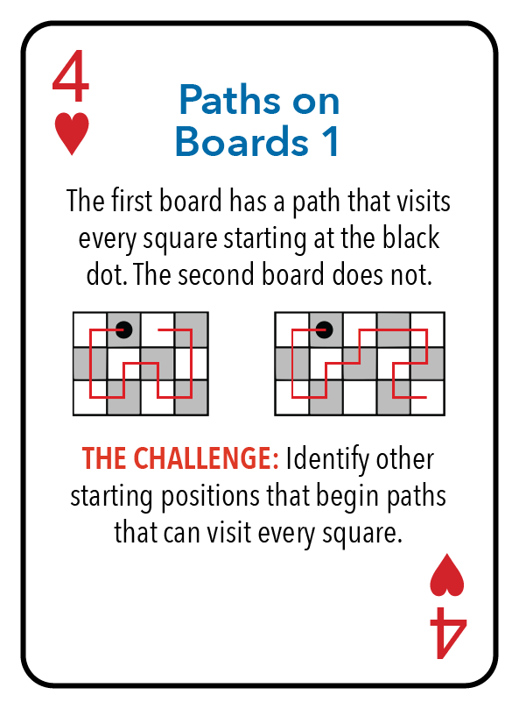
Hints:
Look at either of the example paths. Notice that the colors alternate as you move along either path.
The first rectangle has 12 squares, which is an even number. The second rectangle has 15 squares, which is an odd number. How does that difference change things?
The first rectangle has the same number of white and black squares. In the second rectangle, there is one more white square than the number of black squares. How does that change things?
Puzzle – 4 Hearts

Slide 19
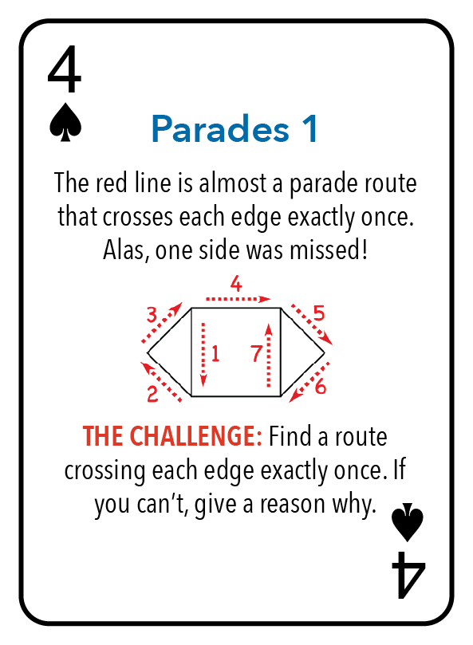
Hints:
Experiment with lots of simple figures that are like this one.
For the figures that have paths that visit every edge, what do you notice about the starting and ending places? Can you always start anywhere and end anywhere, or are there restrictions sometimes?
Puzzle – 4 Spades

Slide 20
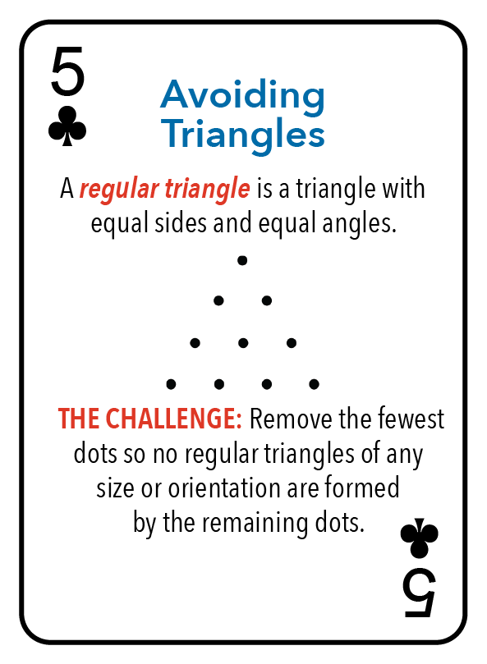
Hints:
Start with a simpler example of the puzzle – play with a triangle with six dots with three dots on the bottom row.
You will find that you only need to remove two dots to make the six-dot triangle work.
How can you apply what you learned from the six-dot triangle to a ten-dot triangle?
Puzzle – 5 Clubs

Slide 21
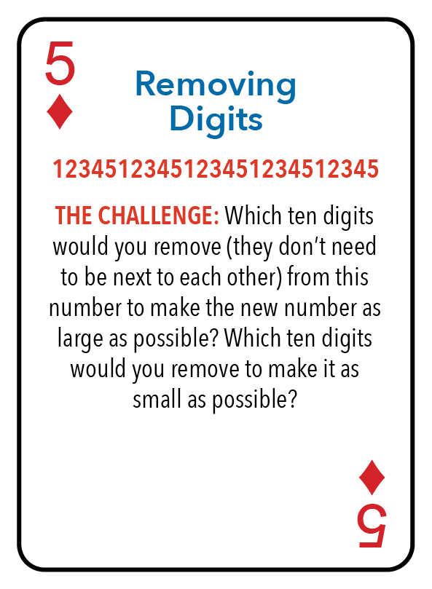
Hints:
Whether making the number large or small, the high-order digits are the most important.
To make it large, make the first two high-order digits 55. To make it small, make the first three 111.
Puzzle – 5 Diamonds

Slide 22
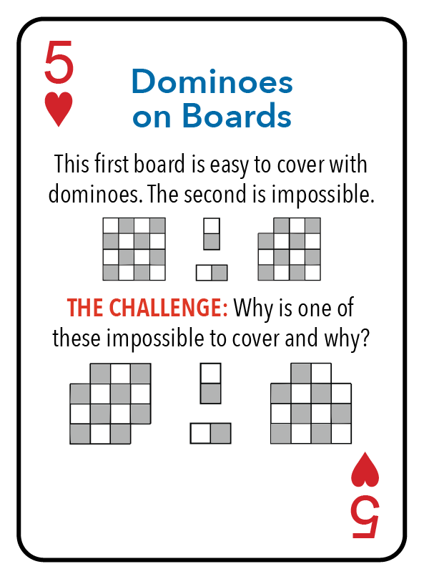
Hints:
Both of the challenge boards have an even number of squares.
Notice that a domino will always cover one white square and one dark square.
How do the number of black squares and white squares compare to each other on each challenge board?
Puzzle – 5 Hearts

Slide 23
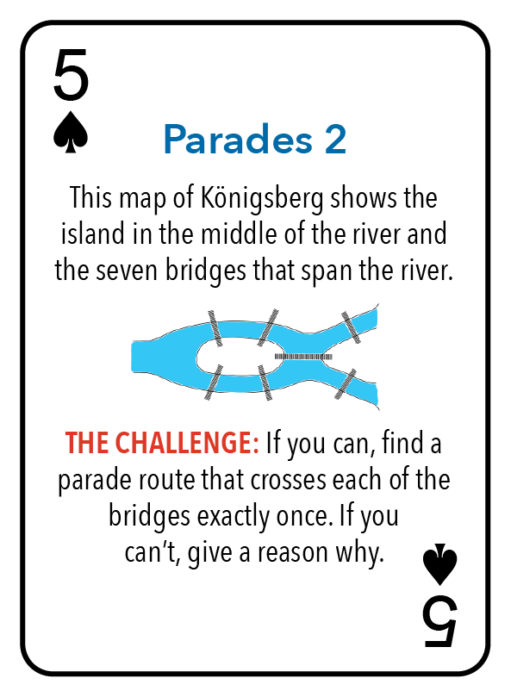
Hints:
What did you learn about paths from the Parades 1 puzzle on the 4 of Spades?
Places that have an odd number of bridges will need to be the start and end of the parade. Why is that a problem?
Puzzle – 5 Spades

Slide 24
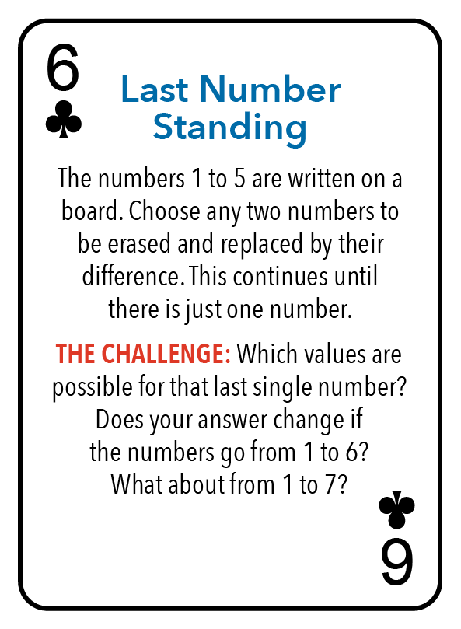
Hints:
Start by pairing up 1 & 2 and 3 & 4. This leaves 1, 1, 5, which can then turn into 5.
Pair up 2 & 3 and 4 & 5. This leaves 1, 1, 1, which can then turn into 1.
How can you predict whether 0 or 1 will be the lowest possible value for a range of numbers?
Puzzle – 6 Clubs

Slide 25
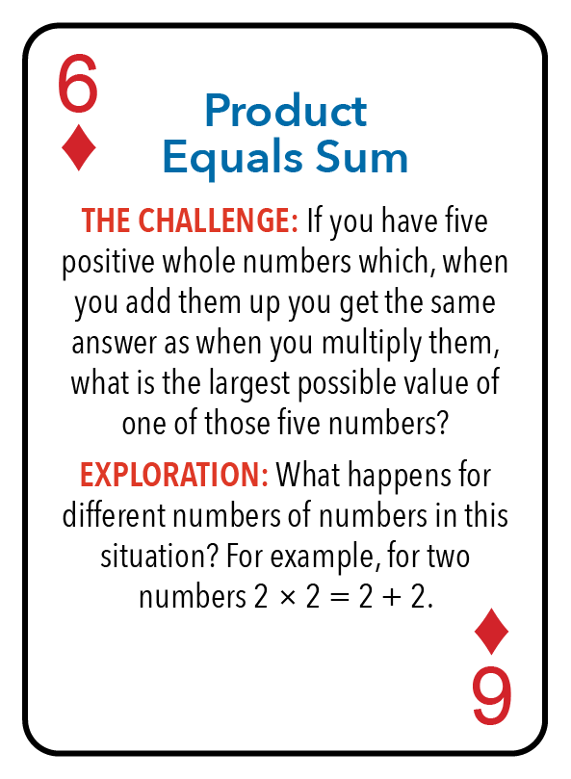
Hints:
How big can the largest of these numbers be?
Organize your thinking by putting these numbers in order.
If x is the largest of the numbers, than the sum can be no bigger than 5x. That means the product of the other four numbers can be no bigger than 5. This leaves very few possibilities.
Puzzle – 6 Diamonds

Slide 26
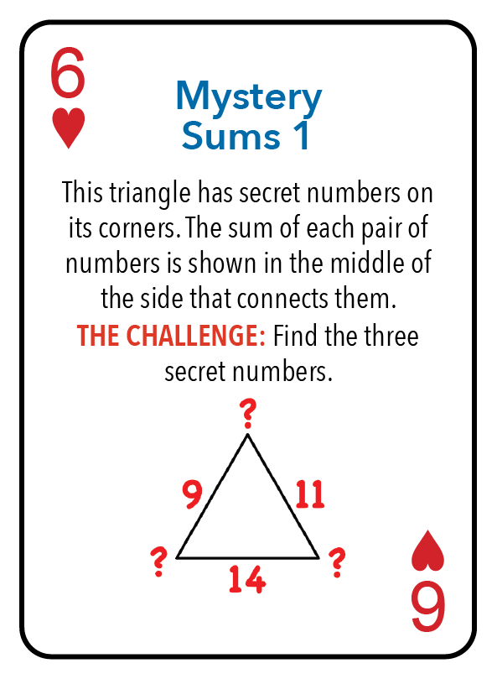
Hints:
The two numbers on the right side add up to two more than the two numbers on the left side.
That means the number on the bottom right is two bigger than the number on the bottom left, and they add up to 14.
Another approach is to add up the three sides. That total is 34, and it is also twice the sum of all three corners.
Puzzle – 6 Hearts

Slide 27
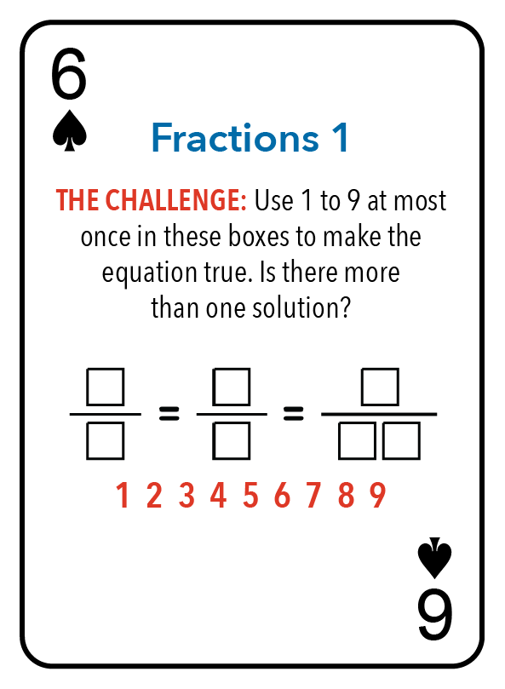
Hints:
Why can’t 5 be one of the numbers used?
Why can’t 7 be one of the numbers used?
Look for compatible denominators.
Puzzle – 6 Spades

Slide 28
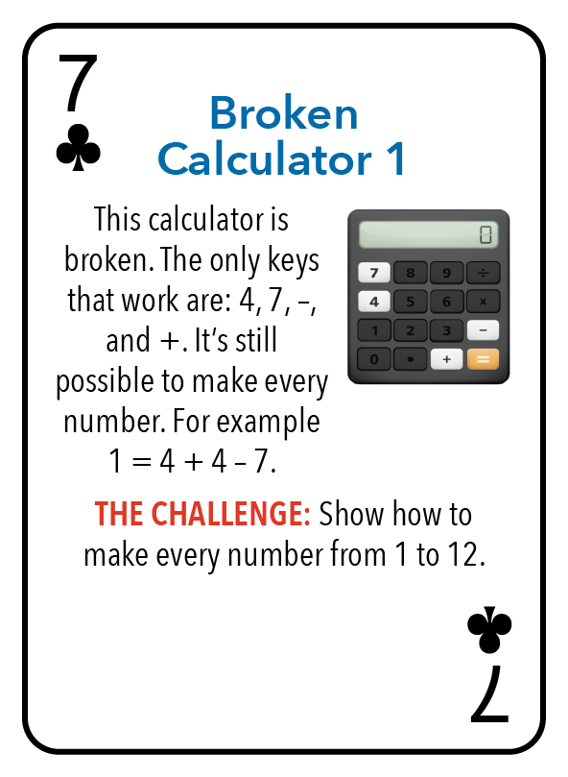
Hints:
One uninteresting way to create all the numbers is to take 1 = 4 + 4 - 7 and multiply it by whatever you need. For example, you can make 3 = 4 + 4 + 4 + 4 + 4 + 4 - 7 - 7 - 7.
Whatever the lowest positive number is, you can make all multiples of it. Note that this lowest positive number will always be the greatest common factor of the two numbers.
Puzzle – 7 Clubs

Slide 29
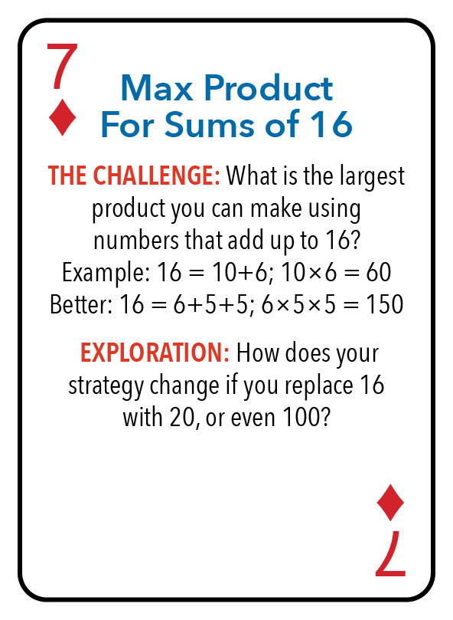
Hints:
Learn from simpler versions of the problem. Start with small sums and work your way up.
Reduce the numbers involved in your sums so that they only involve 2’s and 3’s. For example, you can replace 5 by 2 + 3.
Is it better to have two 3’s or three 2’s? Their sums are the same, but the products are different.
Puzzle – 7 Diamonds

Slide 30
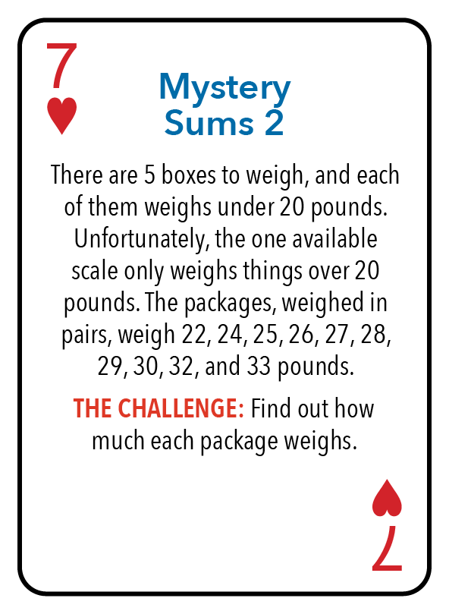
Hints:
Put the packages in order from lightest to heaviest.
What happens if you add up all ten numbers?
The sum of all ten numbers is 276, and that is also four times the sum of the five weights of the packages. So the sum of the five packages is 276 / 4 = 69.
You know what the lightest two weigh (22), and you know what the heaviest two weigh (33), so what does the one in the middle weigh?
The middle value is 69 - 22 - 33 = 14. The lowest plus the middle is 24, and the highest plus the middle is 32.
Puzzle – 7 Hearts

Slide 31
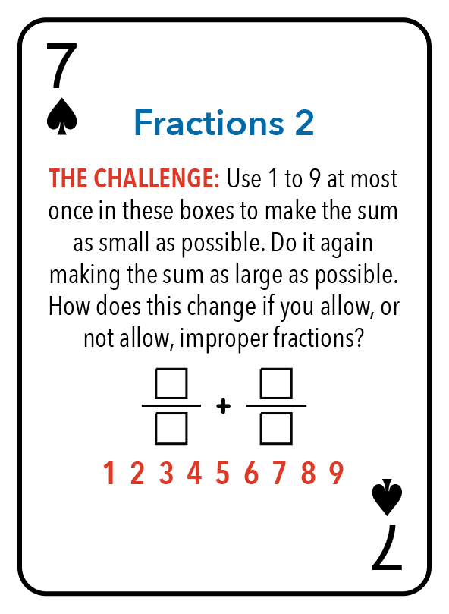
Hints:
What makes a fraction small? What makes a fraction large if it is allowed to be improper? How large can a proper fraction be?
To be small, you either want 1/9 + 2/8 or the reverse 2/9 + 1/8. How can you tell which one is smaller without using a calculator?
To be large and improper, you either want 9/1 + 8/2 or 8/1 + 9/2. Which of these is larger?
To be large and proper, you want the fractions as close to 1 as possible. You want to use fractions such as 8/9, 7/8, 6/7, or 5/6.
Puzzle – 7 Spades

Slide 32
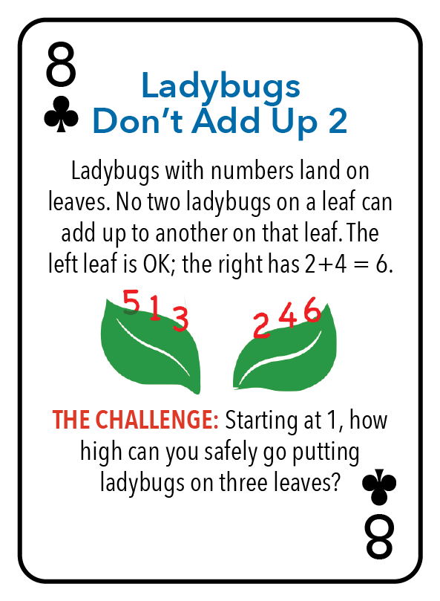
Hints:
Start with a simpler version of the problem.
The best answer, if there are only two leaves involved, is (1, 2, 4, 8) and (3, 5, 6, 7). How can you work with that answer if there are three leaves?
You can use the answer for two leaves and put the numbers 9 to 18 on a third leaf to get a pretty good answer. How can you take that answer and improve it?
You can change the first two leaves to be (1, 2, 4, 8, 22) and (3, 5, 6, 7, 19, 20, 21) to get an excellent answer that goes up to 22. The best answer goes up to 23 by making several minor changes to this.
Puzzle – 8 Clubs

Slide 33
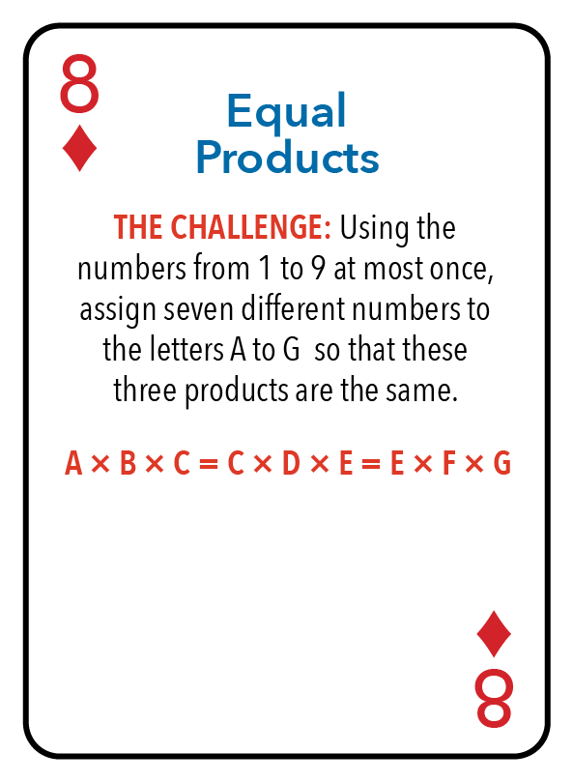
Hints:
The answer will use seven out of the nine numbers. Which two numbers must be left out?
5 and 7 cannot work because they would introduce factors of 5 or 7 that would need to be in all three terms.
Use prime factorizations to analyze this problem. It’s all about counting the 2’s and 3’s.
The product of all seven numbers is 2^7 x 3^4. Given that 8 and 9 must be somewhere, the common product must be at least 2^3 x 3^2.
Puzzle – 8 Diamonds

Slide 34
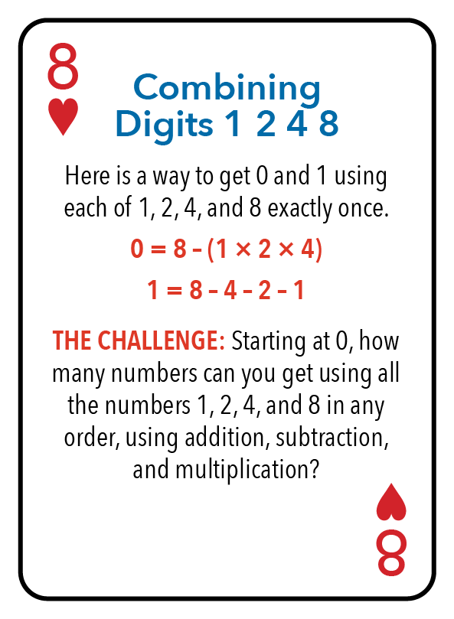
Hints:
Try to get to at least 20, perhaps even to 26.
Puzzle – 8 Hearts

Slide 35
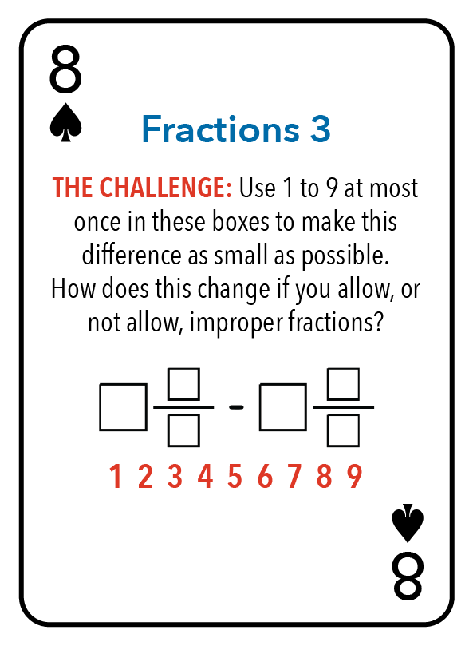
Hints:
If improper fractions are not allowed, then it is impossible for the two mixed numbers to be equal. If they are allowed, then the mixed numbers can be the same.
Using improper fractions, 8 1/2 - 7 6/4 = 0.
Using only proper fractions, we want the first fractional part to be as close to 0 as possible and the second fraction part to be as close to 1 as possible.
Puzzle – 8 Spades

Slide 36
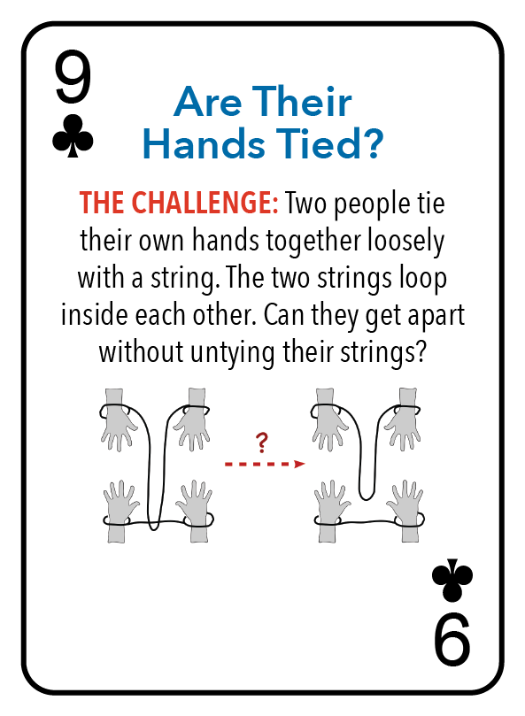
Hints:
There is nothing specifying how tightly the strings are around the wrists.
It is not cheating, and it helps see the answer to the problem, if you take the string around one of the wrists, say the wrist pictured in the lower left, and make the string have *lots* of room around the wrist.
Puzzle – 9 Clubs

Slide 37
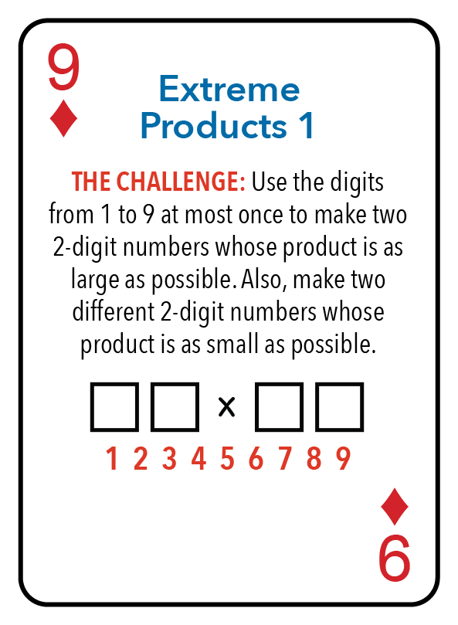
Hints:
To make the product large, we want to use large numbers. So, it will either be 97 x 86 or 96 x 87.
To make the product small, we want to use small numbers. So, it will either be 13 x 24 or 14 x 23.
Puzzle – 9 Diamonds

Slide 38
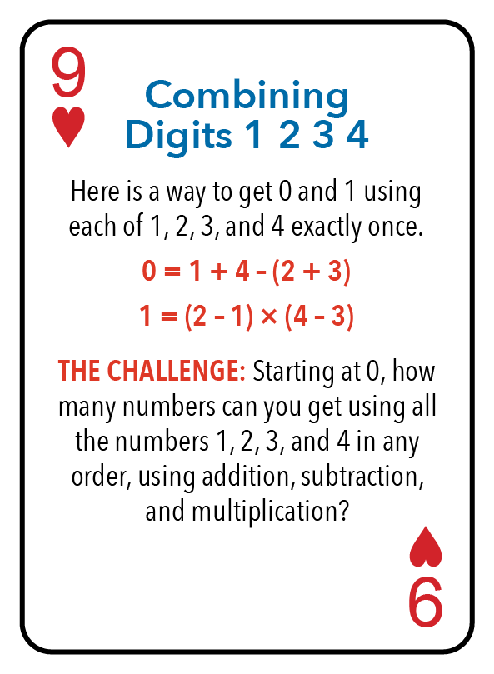
Hints:
It is possible to get all the numbers from 0 to 16.
Puzzle – 9 Hearts

Slide 39
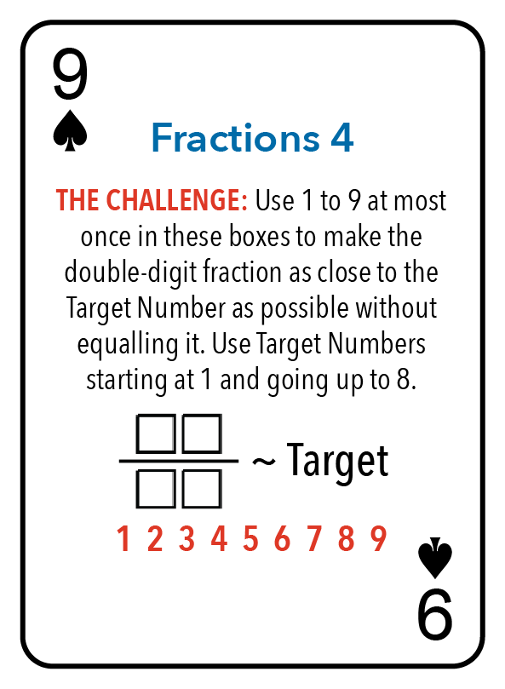
Hints:
The target of 1 will be different than the targets from 2 to 8.
For 1, you want two large numbers that are close together, such as 91/89 (which is not legal, but shows the idea).
For target larger than 1, start with a fraction equal to it that involves large numbers and then shift it slightly. For example, for 3 you could start with 99 / 33.
Puzzle – 9 Spades

Slide 40
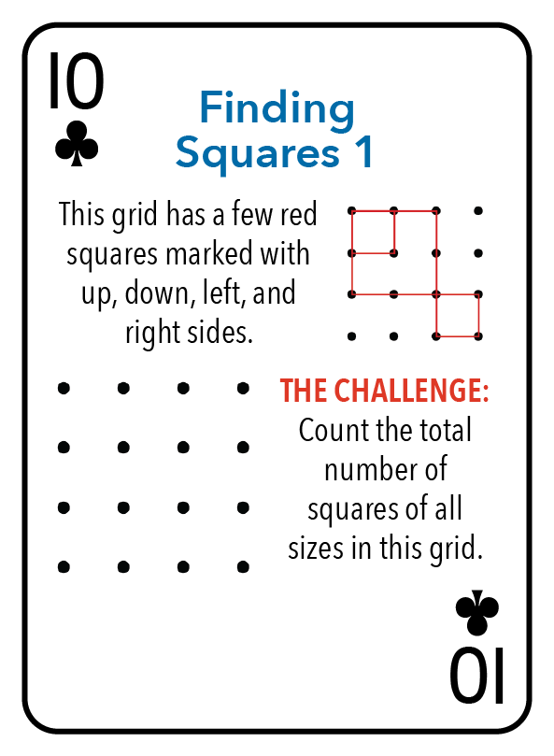
Hints:
Be organized in your counting.
What are the possible sizes for all the different squares?
Puzzle – 10 Clubs

Slide 41
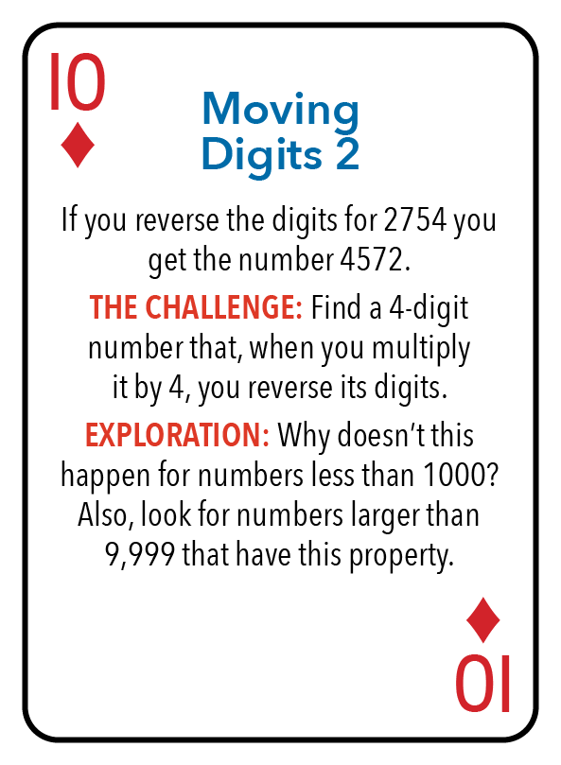
Hints:
What are the possibilities for the thousands digit of the original number?
The thousands digit must be 1 or 2, or the result of multiplying by 4 would be too big. Also, because the result of multiplying by 4 uses this digit as its ones digit, the digit cannot be odd. So, it must be 2, and the original ones digit must be 8.
That logic works no matter how many digits the number has, and it is easy to check that numbers of the from 28 or 2x8 never work.
Use your answer for four-digit numbers to find answers for more digits.
Puzzle – 10 Diamonds

Slide 42
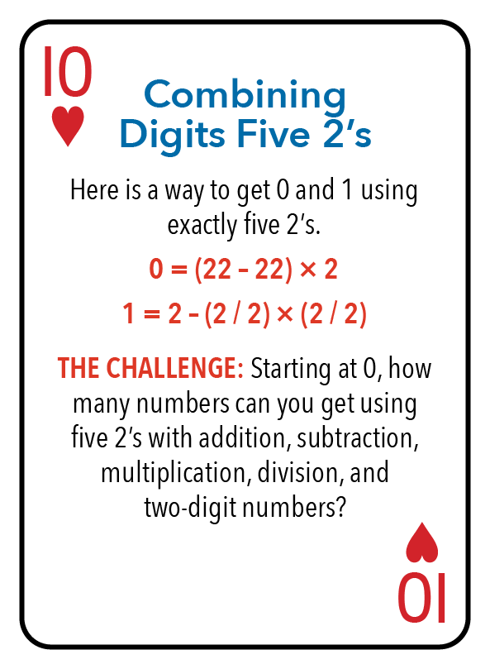
Hints:
Find answers from 0 to 16.
Puzzle – 10 Hearts

Slide 43
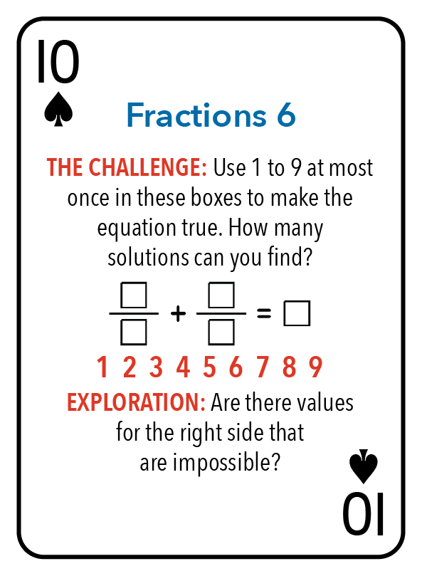
Hints:
There are lots of solutions.
You only need to check the possibly compatible denominators of 1, 2, 3, 4, 6, 8, and 9.
The right side has solutions for all numbers except for 6.
Puzzle – 10 Spades

Slide 44
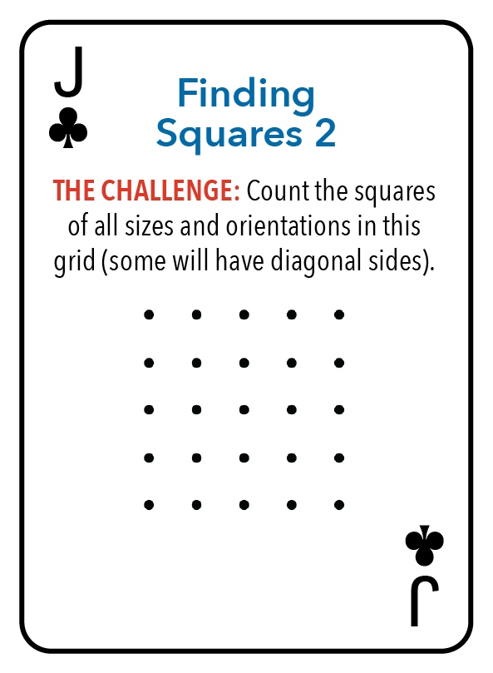
Hints:
As in the puzzle “Finding Squares 1” (10 of Clubs), this calls for careful and organized counting.
Categorize all the squares by what the top side does – in moving from left to right, how many dots does the top side go to the right and how many dots does it go up or down?
Puzzle – J Clubs

Slide 45
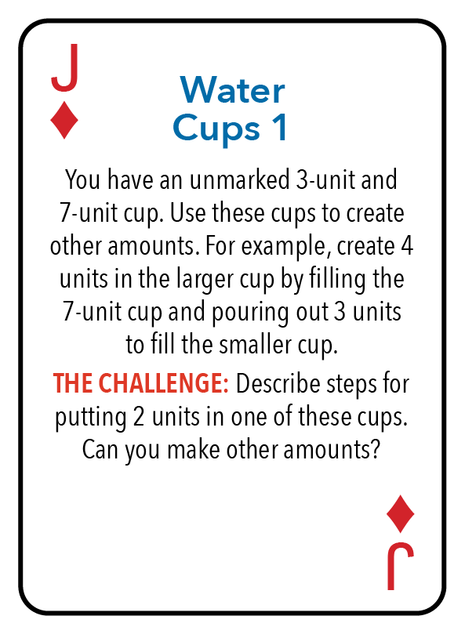
Hints:
As long as you don’t jump around, this puzzle is easier than it seems.
Fill the 7-unit cup and pour it into an empty 3-unit cup (leaving 4 units). Empty the 3-unit cup and pour 3-units from the 7-unit cup (leaving 1 unit). Continue this process, refilling the 7-unit cup as needed, until the 7-unit cup has the right amount.
Puzzle – J Diamonds

Slide 46
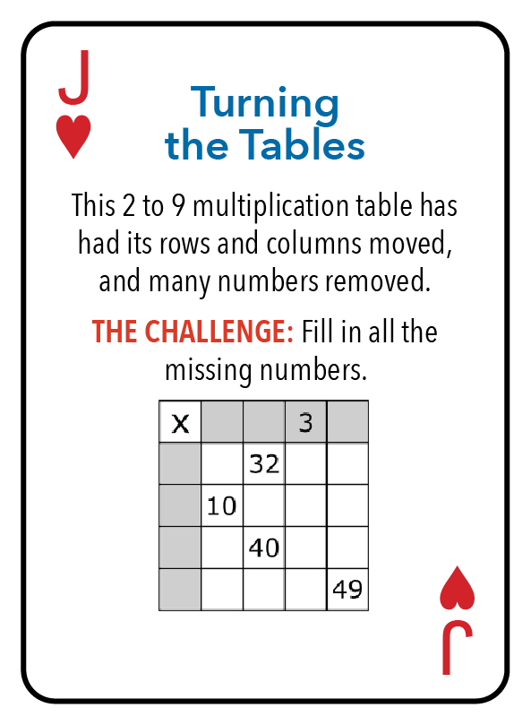
Hints:
Look for the entries that have very few choices.
49 must be 7 x 7, and 40 must be 5 x 8.
10 is 2 x 5, and 10 is not in the 5 row with 40. So 10 must be in the 5 column.
Puzzle – J Hearts

Slide 47
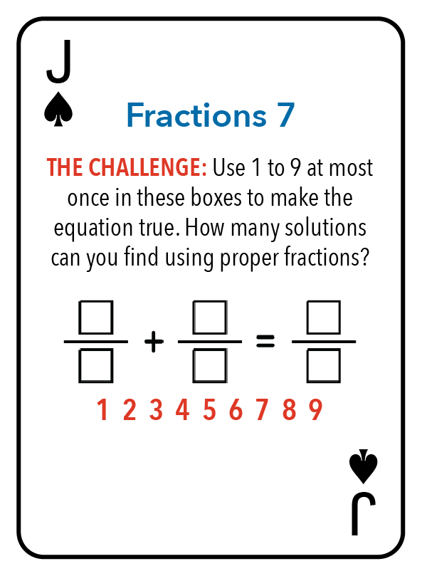
Hints:
You can narrow your search by only looking at denominators that can be compatible – 1, 2, 3, 4, 6, 8, and 9.
Puzzle – J Spades

Slide 48
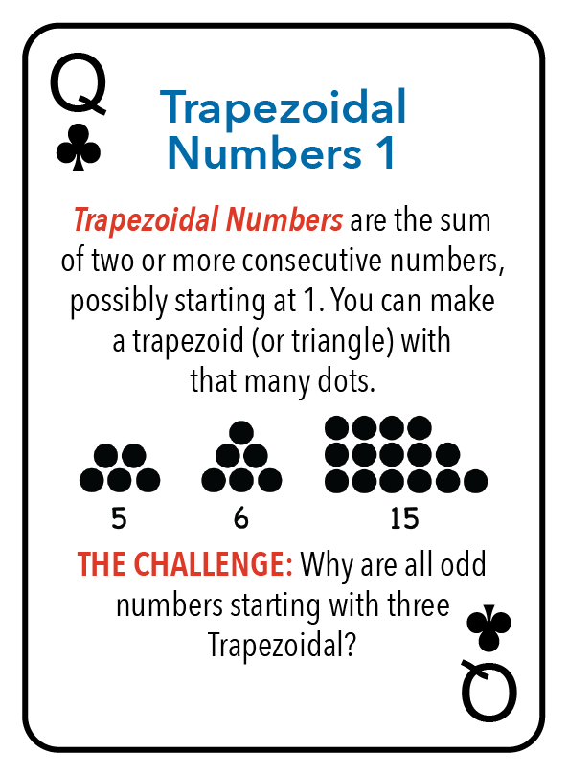
Hints:
Start with some examples.
For each of the first few odd numbers starting at three, draw two rows of dots using that many dots. Why can you always do this for an odd number?
Puzzle – Q Clubs

Slide 49
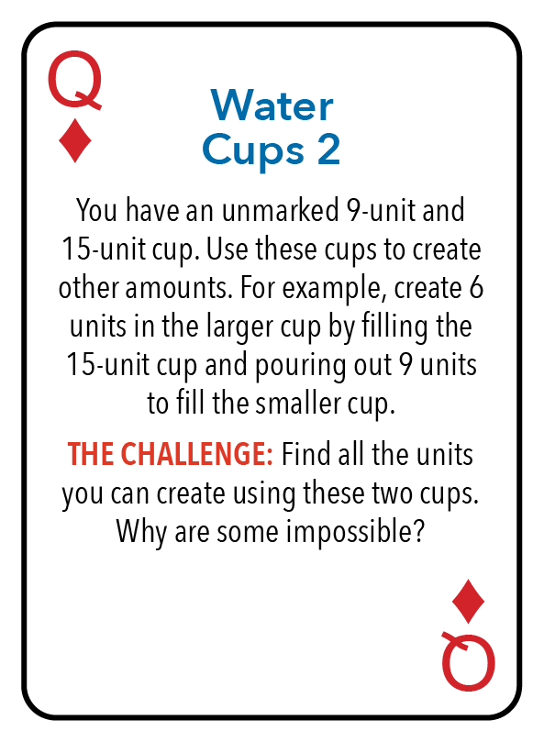
Hints:
When combining 9-unit and 15-unit amounts you are adding and subtracting multiples of 9 and 15.
All multiples of 9 and 15 will be multiples of 3, their greatest common factor.
Puzzle – Q Diamonds

Slide 50
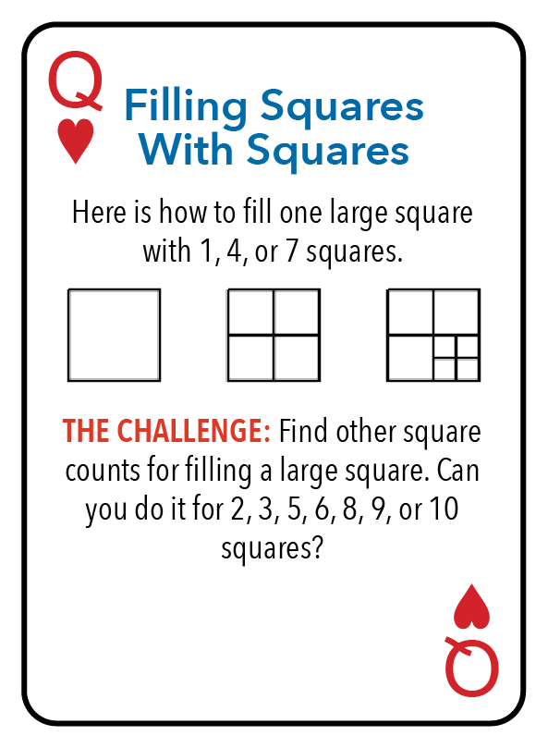
Hints:
You can always replace one of the smaller squares by any other solution. For example, the third example on the right replaces the bottom right square in the middle example with four squares.
When a single square is replaced by four squares, the total number of squares is increased by 3.
You can create six squares by putting five 1 by 1 squares on the bottom and right sides of a 2 by 2 square.
You can create eight squares by putting seven 1 by 1 squares on the bottom and right sides of a 3 by 3 square.
Puzzle – Q Hearts

Slide 51
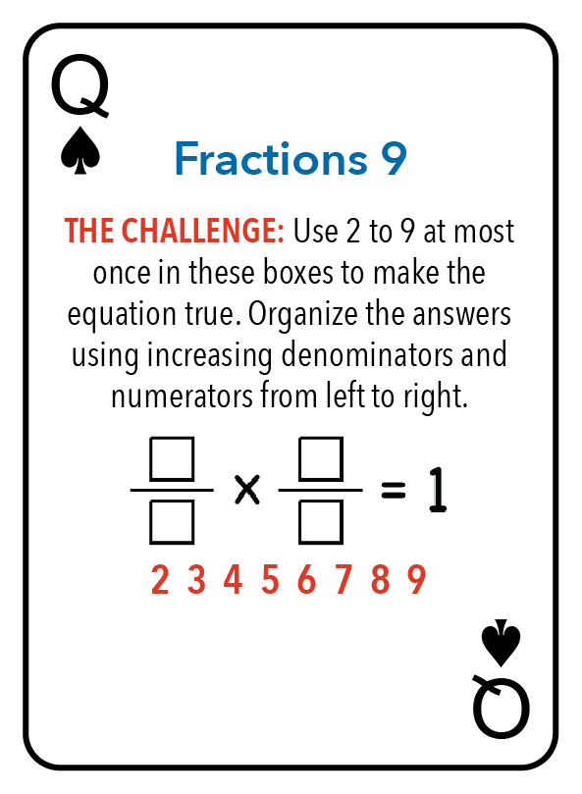
Hints:
Think in terms of prime numbers and prime factorizations.
There is only one 5 and one 7, so they cannot be part of a solution.
There are only three numbers with a factor of 3, so focus on where they can or cannot be.
Puzzle – Q Spades

Slide 52
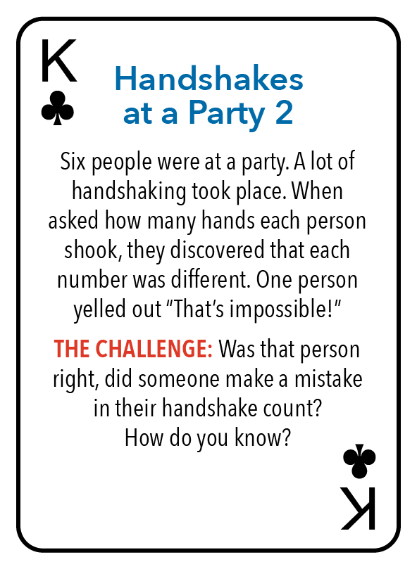
Hints:
There are only six possible numbers for each person’s number of handshakes – the numbers from 0 to 5.
Each of the numbers from 0 to 5 must have occurred exactly once.
It is impossible for one person to shake 5 hands and another person to shake 0 hands.
Puzzle – K Clubs

Slide 53
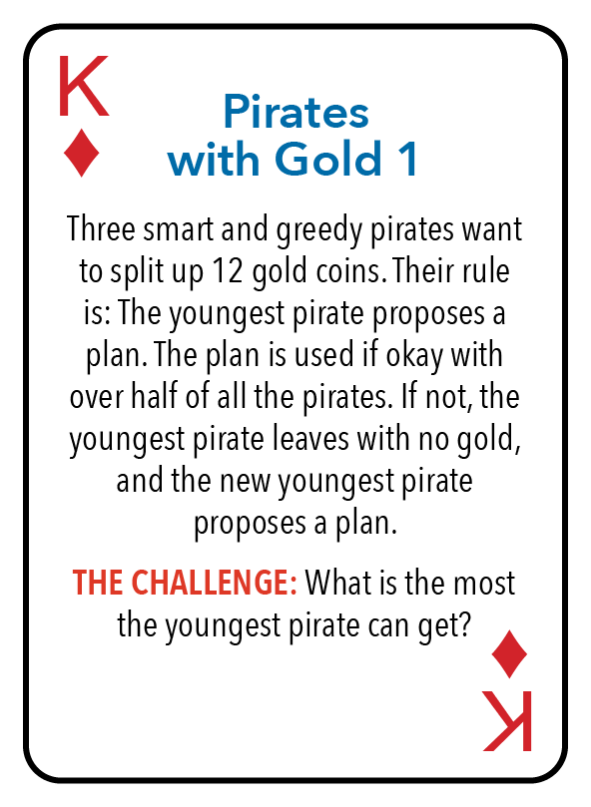
Hints:
Learn from smaller versions of this puzzle.
If there is only one pirate, they get 12 coins.
If there are two pirates, the youngest gets nothing or else the older one will not agree to it.
With three pirates, the youngest only needs to convince one other pirate to agree with him.
What is the least the youngest must give to one of the other pirates to get them to agree?
Keep going! What is the answer when there are four or five pirates?
Puzzle – K Diamonds

Slide 54

Hints:
Look for similarities with the Filling Squares with Squares puzzle (Queen of Hearts).
Replacing an individual smaller triangle with another solution is a good way to get new solutions.
Replacing one triangle with four triangles increases the triangle count by 3.
You can get 6 triangles by placing five triangles along the bottom of a large triangle.
You can get 8 triangles by placing 7 triangles along the bottom of a large triangle.
Puzzle – K Hearts

Slide 55

Hints:
Focus on prime factors and prime factorizations for the first puzzle.
There can be no 5’s or 7’s for the first puzzle.
There must be one more factor of 2 in the numerators than the denominators. There must be one more factor of 3 in the denominators than in the numerators.
For the second puzzle, look for products that are close to multiples of 5 and 11.
Puzzle – K Spades

Slide 56


Slide 57


Slide 58


