Slide 1
52 Math Puzzles for K – 3
These puzzles have links to longer puzzle descriptions and solution notes.
The first few slides have examples of models of possible classroom slides.
Each slide has animated hints if you want to use them. These hints often have optional solution strategies that provide insights but are not needed for having fun with the puzzles.

Slide 2
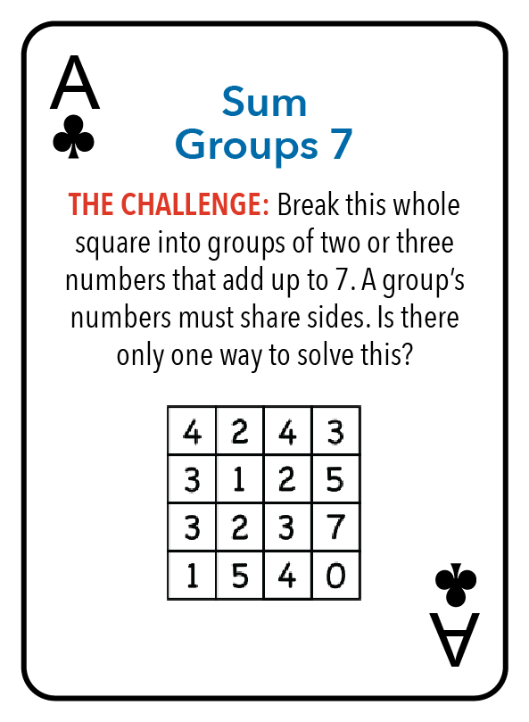
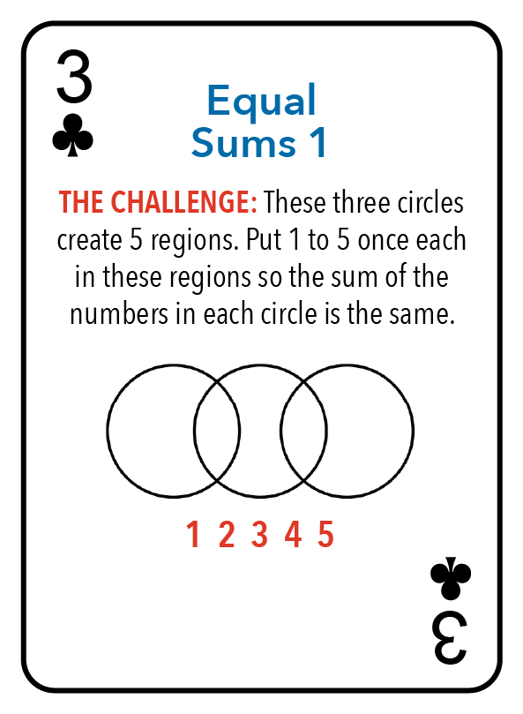
Example Slide 1
Choose
Your
Challenge
Puzzle – Ace Clubs
Puzzle – 3 Clubs

Slide 3
Example Slide 2
What is your strategy?
What are good places to start on this puzzle?
Puzzle – Ace Clubs

Slide 4
Hints:
Look for very large or very small numbers, especially near corners and sides – they may only have one choice.
Start with 7 and 0. They must go together.
That determines two pairs next to the 7 and 0. The 2 and 5 go together, and the 4 and 3 go together.
Puzzle – Ace Clubs
Notes:
Hints:
Look for very large or very small numbers – they may only have one choice.
Start with 7 and 0. They must go together.
That determines two pairs next to the 7 and 0. The 2 and 5 go together, and the 4 and 3 go together.

Slide 5
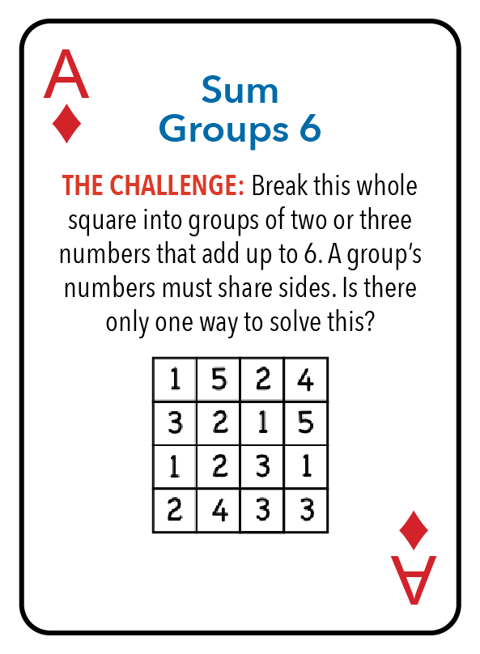
Hints:
Look for very large or very small numbers, especially near corners and sides – they may only have one choice.
Start with 5 and 1 in the upper left, the 4 and 2 in the upper right, and the 3 and 3 in the lower right.
Puzzle – Ace Diamonds

Slide 6
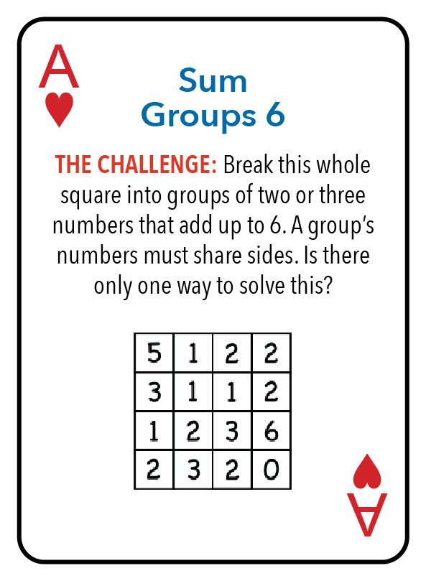
Hints:
Look for very large or very small numbers, especially near corners and sides – they may only have one choice.
Start with 5 and 1 in the upper left, and the 6 and 0 in the lower right.
Puzzle – Ace Hearts

Slide 7
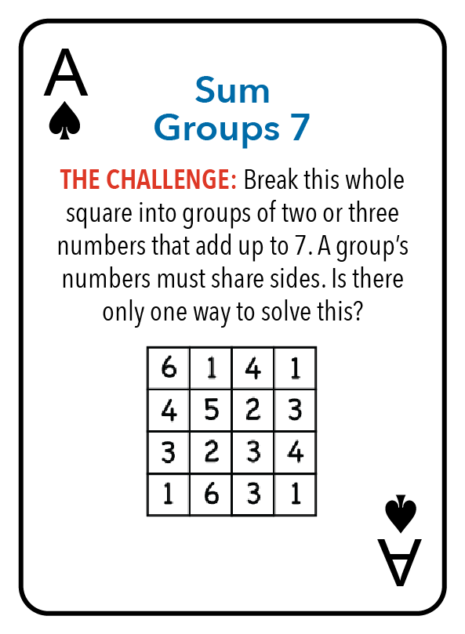
Hints:
Look for very large or very small numbers, especially near corners and sides – they may only have one choice.
Start with 6 and 1 in the upper left, and the 6 and 1 in the lower left.
Puzzle – Ace Spades

Slide 8
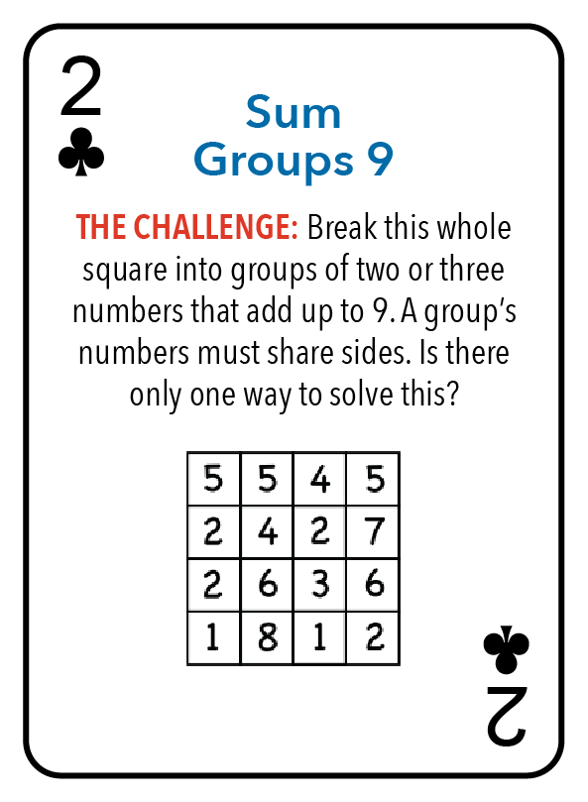
Hints:
Look for very large or very small numbers, especially near corners and sides – they may only have one choice.
Start with 5 and 4 in the upper right, the 7 and 2 just below that, and the 5 and 4 just to the left of those two pairs.
Puzzle – 2 Clubs

Slide 9
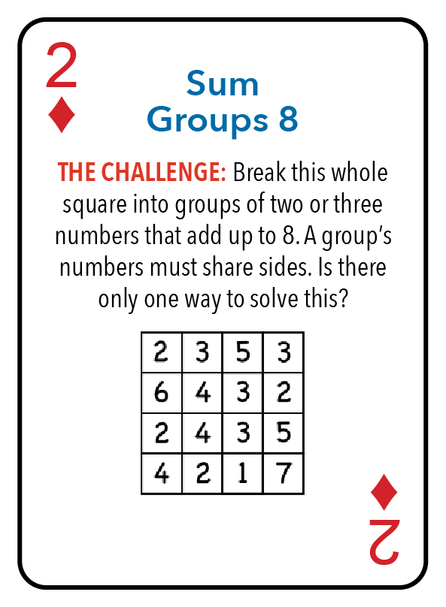
Hints:
Look for very large or very small numbers, especially near corners and sides – they may only have one choice.
Start with 7 and 1 in the lower right, the 3 and 5 just above that, and the 2 and 6 in the upper left.
Puzzle – 2 Diamonds

Slide 10
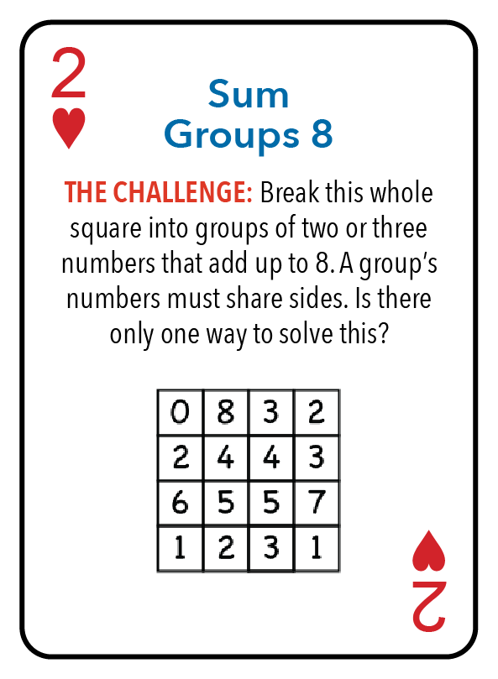
Hints:
Look for very large or very small numbers, especially near corners and sides – they may only have one choice.
Start with 8 and 0 in the upper left, and the 7 and 1 in the lower right.
Puzzle – 2 Hearts

Slide 11
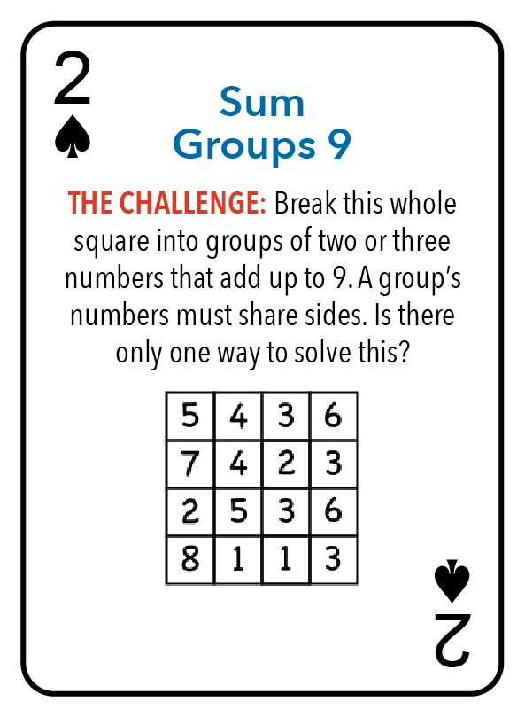
Hints:
Look for very large or very small numbers, especially near corners and sides – they may only have one choice.
Start with 7 and 2 on the left side, and the 8 and 1 in the lower left.
Puzzle – 2 Spades

Slide 12
Hints:
In a puzzle like this, it often helps to find a way to put together several of the same sum so that it involves all the numbers – and look at the situation in two ways.
Add up the three circles not concerning yourself with overlaps. That adds up to three times the sum of one circle. It is also the sum of all the numbers plus the two numbers in the overlap regions. That means that 3 times the sum of a circle is 15 plus the two overlaps.
The smallest the two overlaps can add up to is 1 + 2, and the largest is 4 + 5. So, the sum for each circle is either 6, 7, or 8.
Puzzle – 3 Clubs

Slide 13
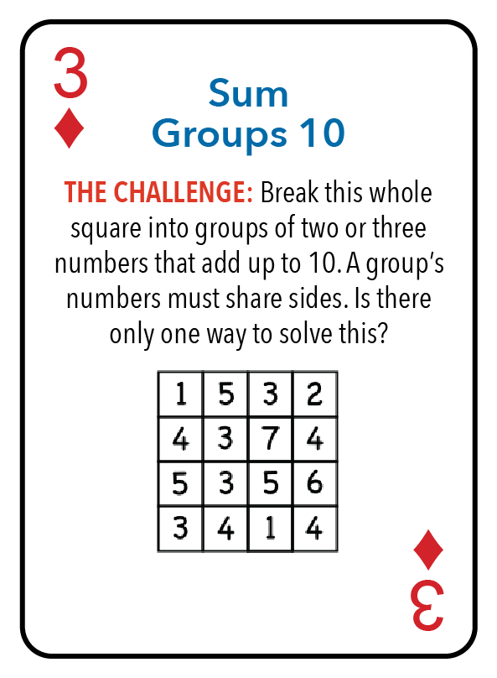
Hints:
Look for very large or very small numbers, especially near corners and sides – they may only have one choice.
Sometimes there is no place that qualifies. On this puzzle, the 4 on the right side has no good match other than the 6 below it. After that, the 2 - 3 - 5 trio along the top must go together.
Puzzle – 3 Diamonds

Slide 14
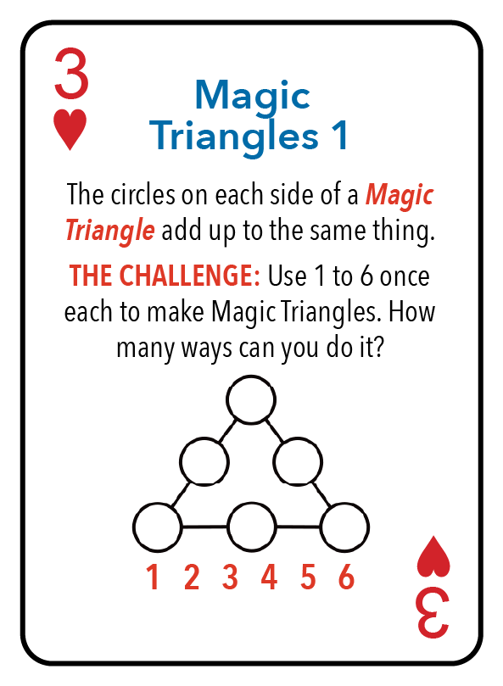
Hints:
In a puzzle like this, it often helps to find a way to put together several of the same sum so that it involves all the numbers – and look at the situation in two ways.
Add up the three sides not concerning yourself with overlaps at the corners. That adds up to three times the sum of one side. It is also the sum of all the numbers plus the three numbers in the corners. That means that 3 times the sum of a side is 21 plus the three corners.
The smallest the three corners can add up to is 1 + 2 + 3, and the largest is 4 + 5 + 6. So, the sum for each side is either 9, 10, 11, or 12.
If you start with one solution, you can arrive at another by subtracting all the entries from 7. This reduces the search to just finding answers for sums 9 and 10.
Puzzle – 3 Hearts

Slide 15
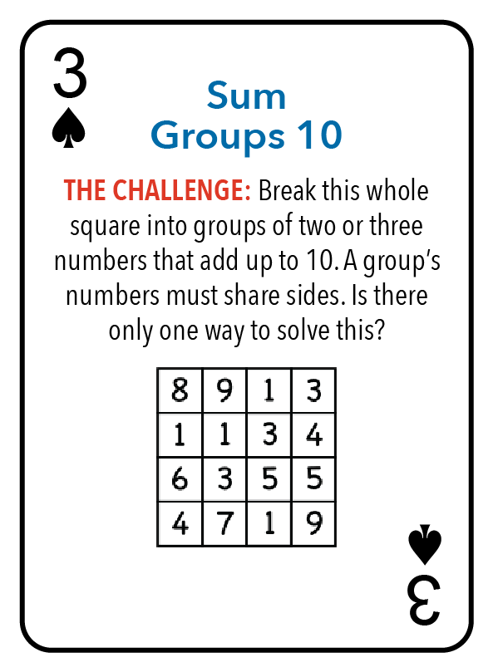
Hints:
Look for very large or very small numbers, especially near corners and sides – they may only have one choice.
Start with 9 and 1 in the lower right, the 5 and 5 above that, and the 3 and 7 to the left of those two pairs.
Puzzle – 3 Spades

Slide 16
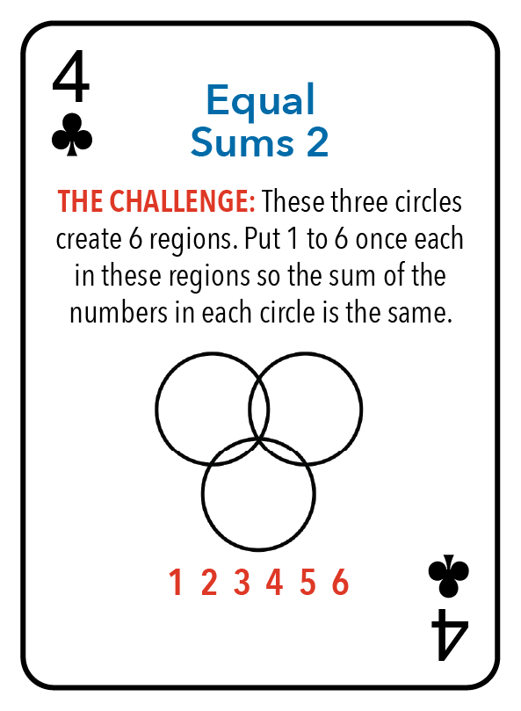
Hints:
In a puzzle like this, it often helps to find a way to put together several of the same sum so that it involves all the numbers – and look at the situation in two ways.
Add up the three circles not concerning yourself with overlaps. That adds up to three times the sum of one circle. It is also the sum of all the numbers plus the three numbers in the overlap regions. That means that 3 times the sum of a circle is 21 plus the three overlaps.
The smallest the three overlaps can add up to is 1 + 2 + 3, and the largest is 4 + 5 + 6. So, the sum for each circle is either 9, 10, 11, or 12.
If you start with one solution, you can find another by subtracting all the entries from 7. This reduces the search to just finding answers for sums 9 and 10.
Puzzle – 4 Clubs

Slide 17
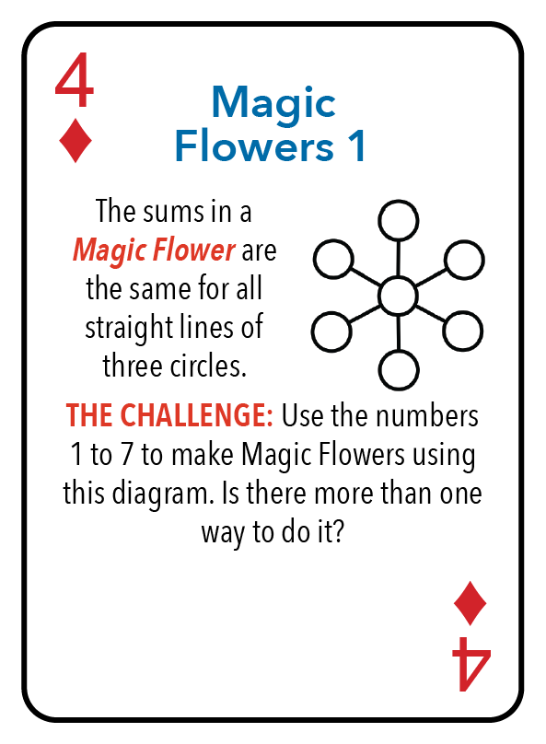
Hints:
In a puzzle like this, it often helps to find a way to put together several of the same sum so that it involves all the numbers – and look at the situation in two ways.
Add up the three lines not concerning yourself with overlap in the center. That adds up to three times the sum of one line. It is also the sum of all the numbers plus the center two extra times. That means that 3 times the sum of a line is 28 plus two times the center.
The smallest the center can be is 1, and the largest is 7. So, the sum for each line is either 10 (center 1), 12 (center 4), or 14 (center 7).
If you start with one solution, you can find another by subtracting all the entries from 8. This reduces the search to just finding answers for sums 10 or 12.
Puzzle – 4 Diamonds

Slide 18
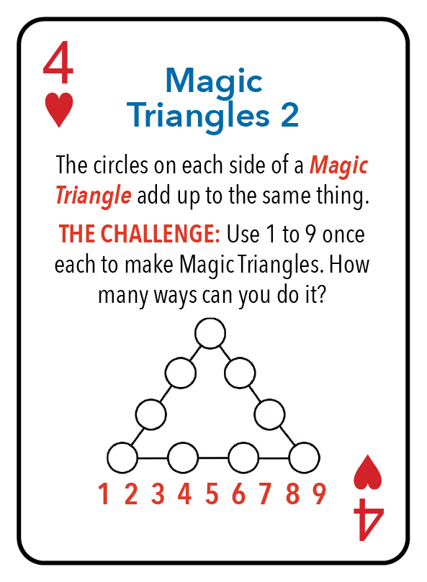
Hints:
In a puzzle like this, it often helps to find a way to put together several of the same sum so that it involves all the numbers – and look at the situation in two ways.
Add up the three lines not concerning yourself with overlaps in the corners. That adds up to three times the sum of one line. It is also the sum of all the numbers plus the three numbers in the corners. That means that 3 times the sum of a line is 45 plus the three corners.
The smallest the three overlaps can add up to is 1 + 2 + 3, and the largest is 7 + 8 + 9. So, the sum for each line is either 17, 18, 19, 20, 21, 22, or 23.
If you start with one solution, you can find another by subtracting all the entries from 10. This reduces the search to finding answers for sums 17, 18, 19, and 20.
Puzzle – 4 Hearts

Slide 19
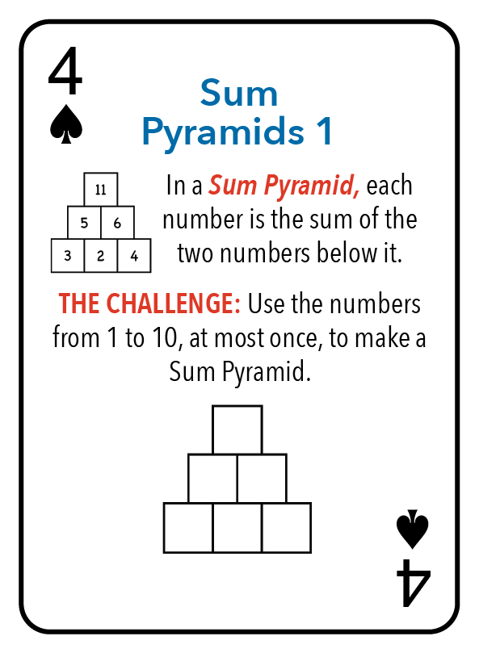
Hints:
There are many solutions.
Notice that the top number is the sum of the two bottom corners plus two times the middle bottom number.
For more of a challenge, find the Sum Pyramid with six numbers that has the smallest value for the top number.
Puzzle – 4 Spades

Slide 20
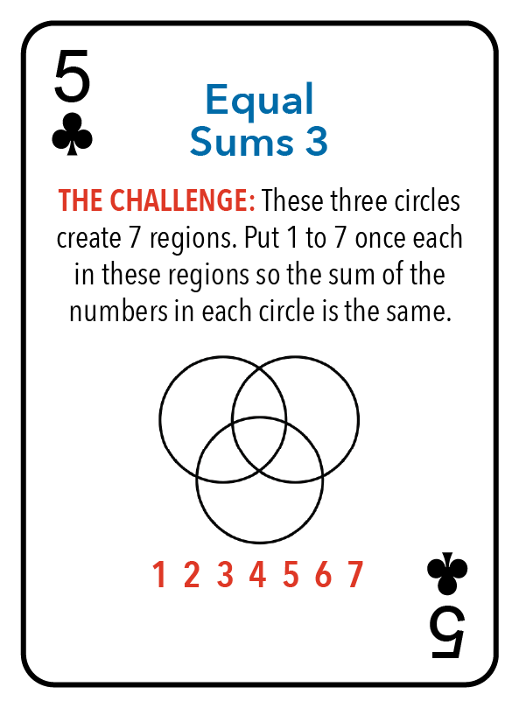
Hints:
In a puzzle like this, it often helps to find a way to put together several of the same sum so that it involves all the numbers – and look at the situation in two ways.
Add up the three circles not concerning yourself with overlaps. That adds up to three times the sum of one circle. It is also the sum of all the numbers (28), plus the three numbers in the single overlap regions, plus twice the center number.
The smallest the the four overlaps can be is (1 + 1) + 2 + 3 + 4 = 11, and the largest is (7 + 7) + 4 + 5 + 6 = 29. So, the sum for each circle is between 13 and 19.
If you start with one solution, you can find another by subtracting all the entries from 8. This reduces the search to just finding answers for sums 13 to 16.
Puzzle – 5 Clubs

Slide 21
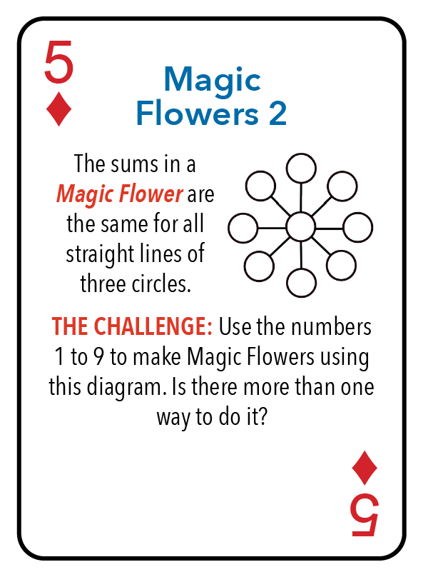
Hints:
In a puzzle like this, it often helps to find a way to put together several of the same sum so that it involves all the numbers – and look at the situation in two ways.
Add up the four lines not concerning yourself with overlaps. That adds up to four times the sum of one line. It is also the sum of all the numbers (45), plus three times the central number.
The smallest the center can be is 1, and the largest is 9. So, the sum for each line is between 12 to 18.
If you start with one solution, you can find another by subtracting all the entries from 10. This reduces the search to finding answers for sums between 12 and 15.
Puzzle – 5 Diamonds

Slide 22
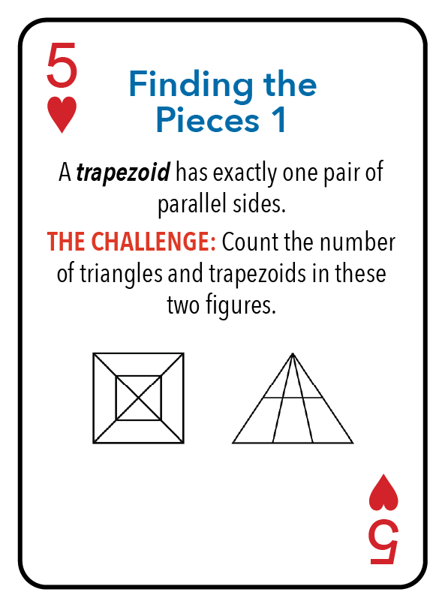
Hints:
Be organized! The challenge is to identify the shapes and sizes of the different types of triangles and trapezoids that occur, and then count the number for each type.
Puzzle – 5 Hearts

Slide 23
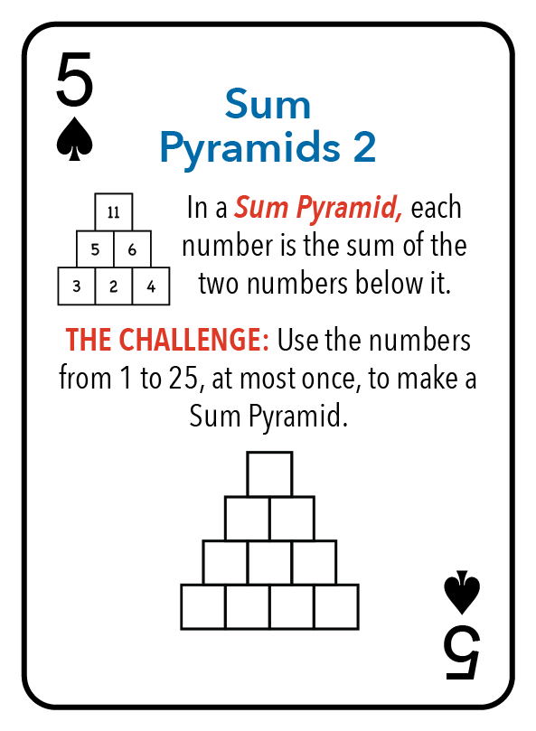
Hints:
There are many solutions.
After a few are done, notice that the top number is the sum of the two bottom corners plus three times the sum of the two middle bottom numbers. Why?
For more of a challenge, find the Sum Pyramid with ten numbers that has the smallest value for the top number.
Puzzle – 5 Spades

Slide 24
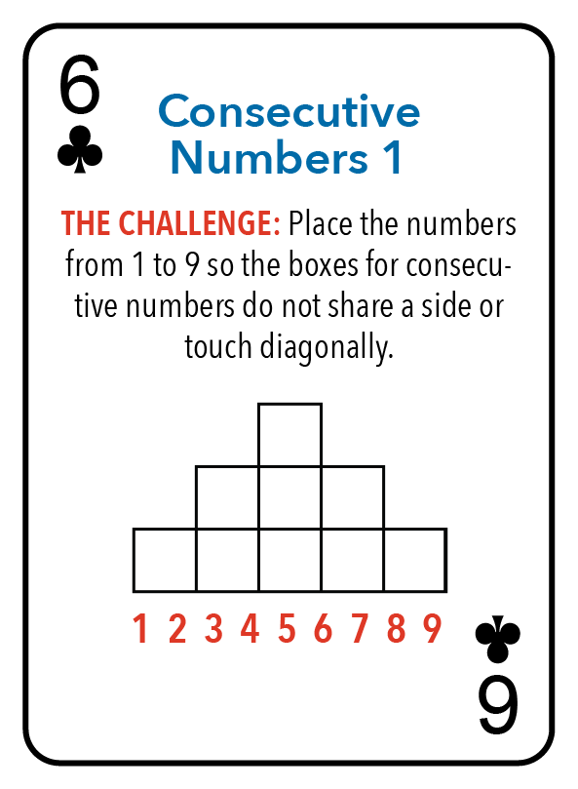
Hints:
The two numbers 1 and 9 are different from the rest for this puzzle – why?
What are good places for 1 and 9 to go?
Puzzle – 6 Clubs

Slide 25
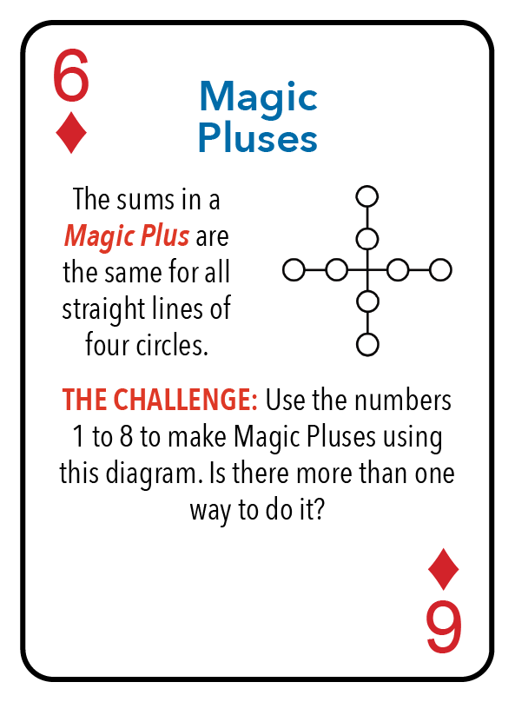
Hints:
The sum of the numbers from 1 to 8 is 36.
Half the numbers are used in one direction, and half in the other direction; so the sum for each line is 18. There are lots of solutions.
Puzzle – 6 Diamonds

Slide 26
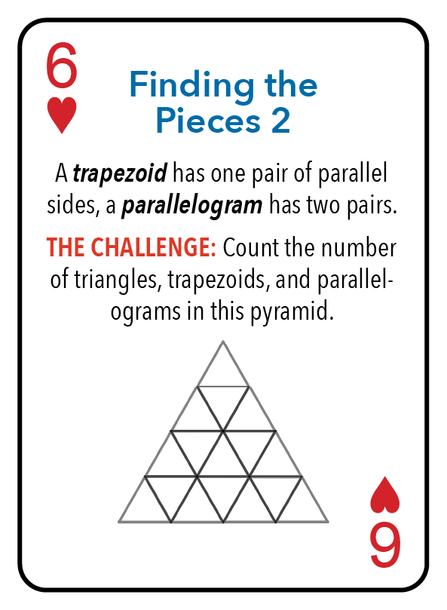
Hints:
Many of the shapes are rotated or flipped from the way you would expect.
Be organized! The challenge is to identify the shapes and sizes of the different types of triangles, trapezoids, and parallelograms that occur, and then count the number for each type.
Puzzle – 6 Hearts

Slide 27
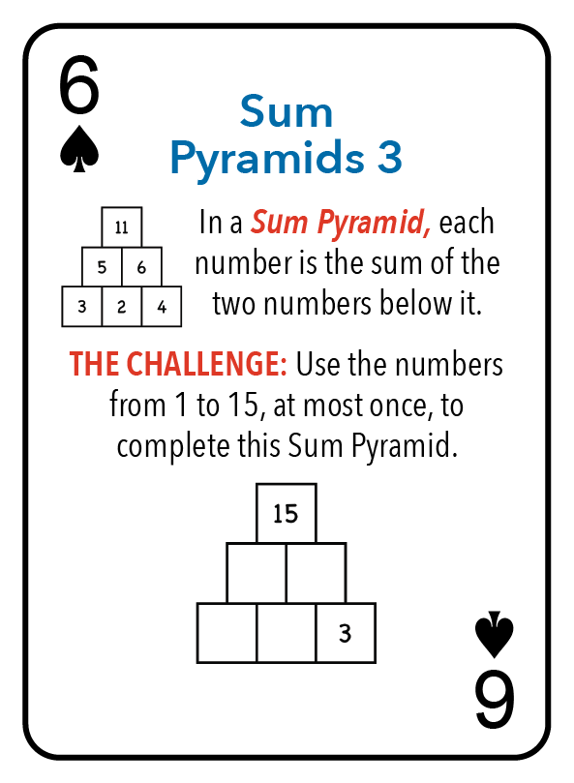
Hints:
For a six-number pyramid, the top number will always be the sum of the two bottom corners plus twice the bottom number in the middle.
So, 15 - 3 = 12 is the bottom left corner plus twice the bottom middle. The possibilities for 12 are 2 + 2(5), 4 + 2(4), 6 + 2(3), 8 + 2(2), and 10 + 2(1). Which ones work out?
Puzzle – 6 Spades

Slide 28
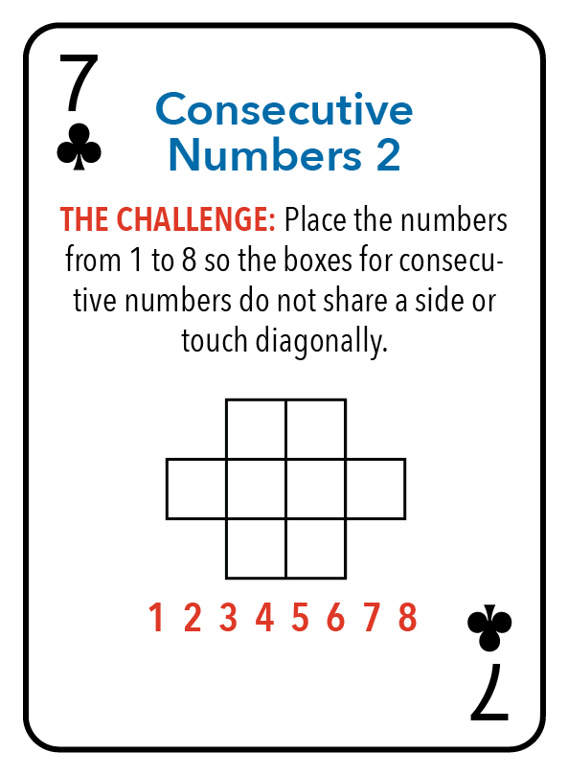
Hints:
The two numbers 1 and 8 are different from the rest for this puzzle – why?
What are the best places for 1 and 8 to go?
Puzzle – 7 Clubs

Slide 29
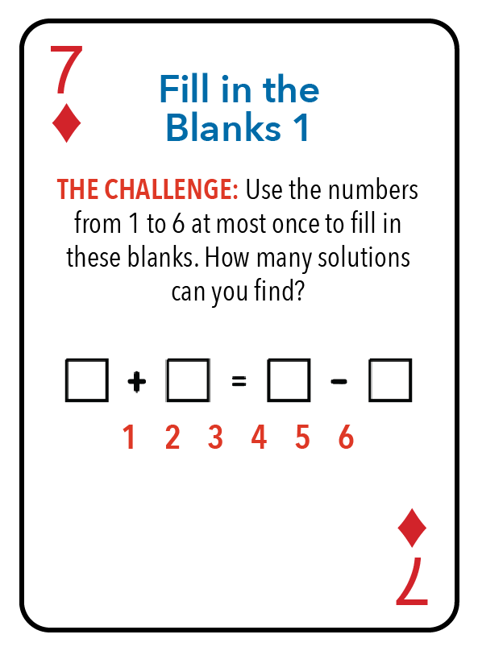
Hints:
Which side of this equation is the best at narrowing the search?
There are three solutions. Can you find them all?
Is there a solution only using the numbers from 1 to 5?
Puzzle – 7 Diamonds

Slide 30
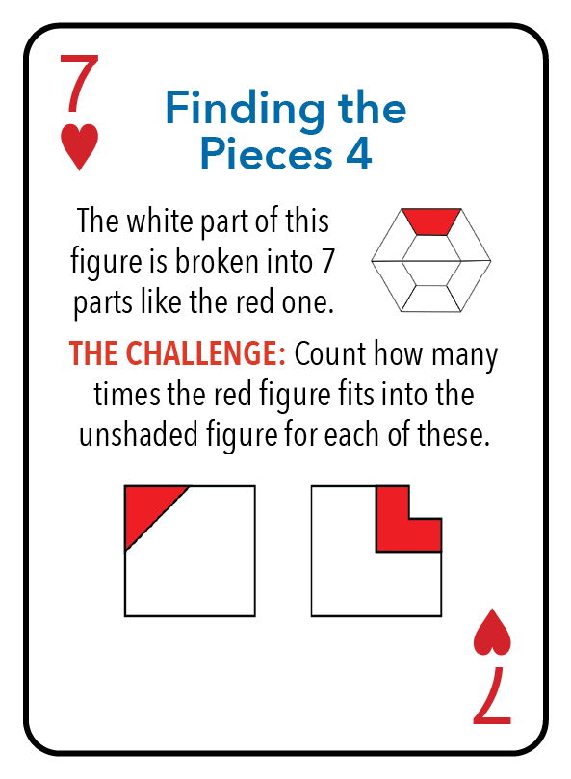
Hints:
For the left figure, what shape can you make by putting two of the red triangles together?
For the right figure, don’t try to do it all at once. Start with putting the red shape in the upper left corner. There is only way to put it there that leads to a solution.
Puzzle – 7 Hearts

Slide 31
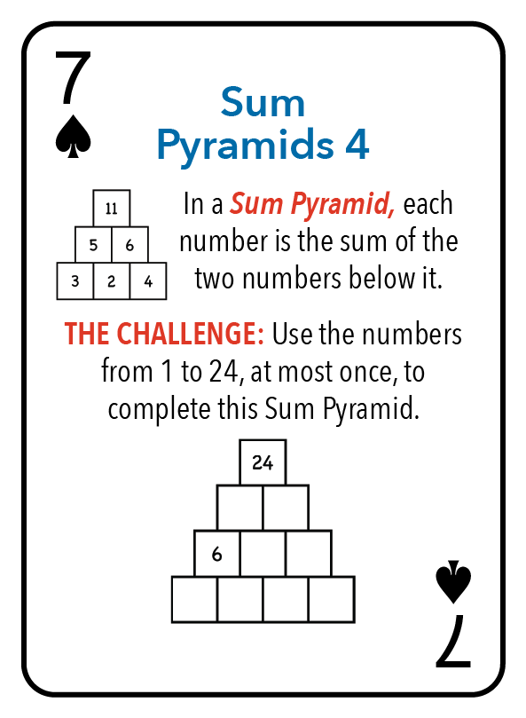
Hints:
There are only four possibilities for the bottom left corner – 1 and 5, 5 and 1, 2 and 4, and 4 and 2.
Recall from the 5 of Spades puzzle – the top number is the sum of the two bottom corners plus three times the sum of the two middle bottom numbers.
There are three solutions.
Puzzle – 7 Spades

Slide 32
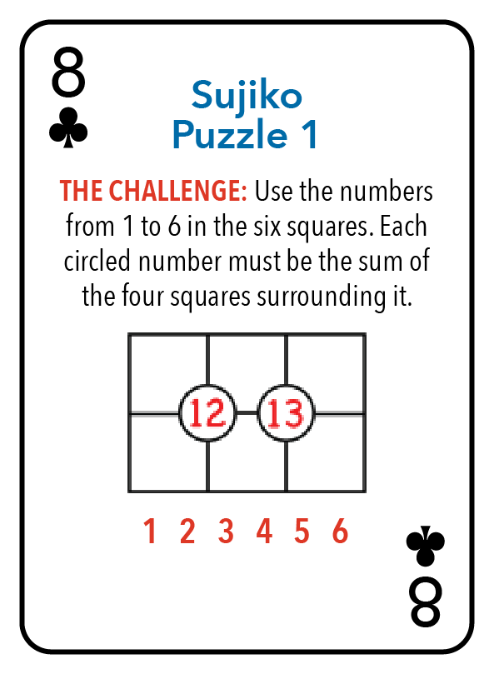
Hints:
25 = 12 + 13 is the sum of the left 2 by 2 and the right 2 by 2. This involves the sum of all the numbers 1 to 6 (21), plus the two middle numbers an extra time. The two middle numbers must add up to 4.
There are eight solutions which are essentially the same – each pair in a column can be flipped without changing the rest of the puzzle.
Puzzle – 8 Clubs

Slide 33
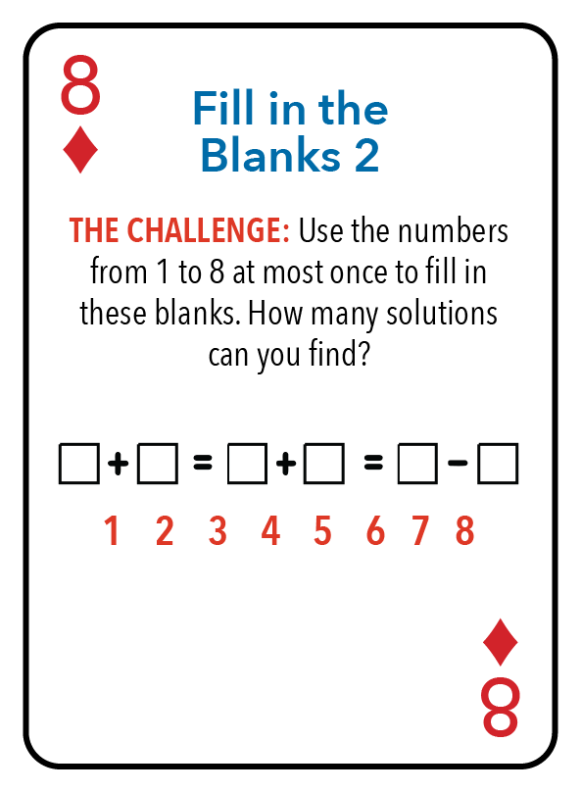
Hints:
As in the 7 of Diamonds puzzle, which part of this is the best at narrowing the search?
What goes wrong if the difference on the right side is six or smaller?
Puzzle – 8 Diamonds

Slide 34
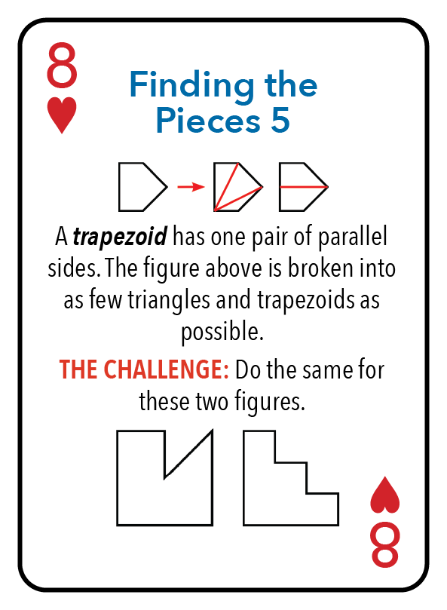
Hints:
The figure on the left can be broken into three triangles or three trapezoids. The figure on the right can be broken into four triangles or three trapezoids.
Puzzle – 8 Hearts

Slide 35
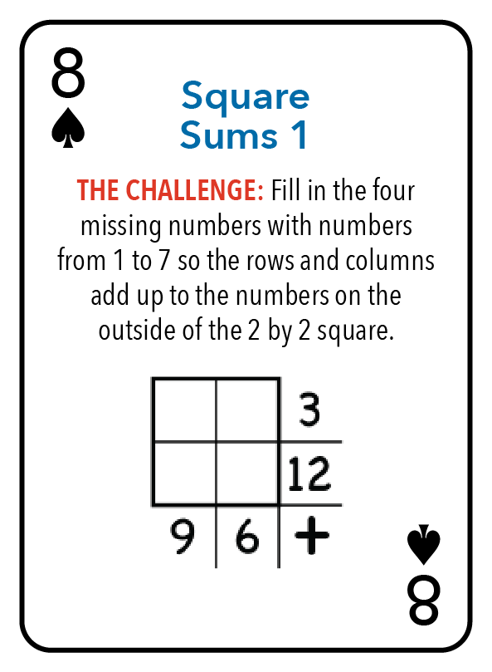
Hints:
The top row must be 1 and 2.
The 1 cannot go in the column that adds up to 9.
Puzzle – 8 Spades

Slide 36
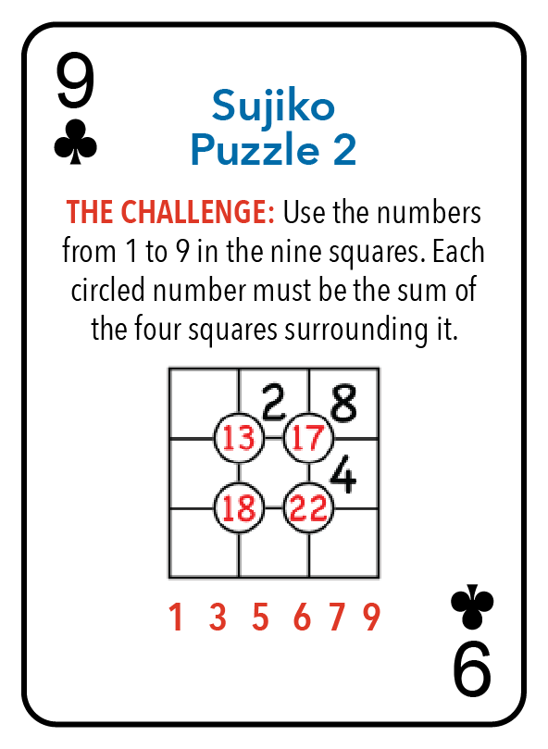
Hints:
For the upper right 2 by 2 to add up to 17, the central square must be 3.
With the 3 in the center, for the lower right 2 by 2 to add up to 22, the two bottom right squares must be 6 and 9.
Puzzle – 9 Clubs

Slide 37
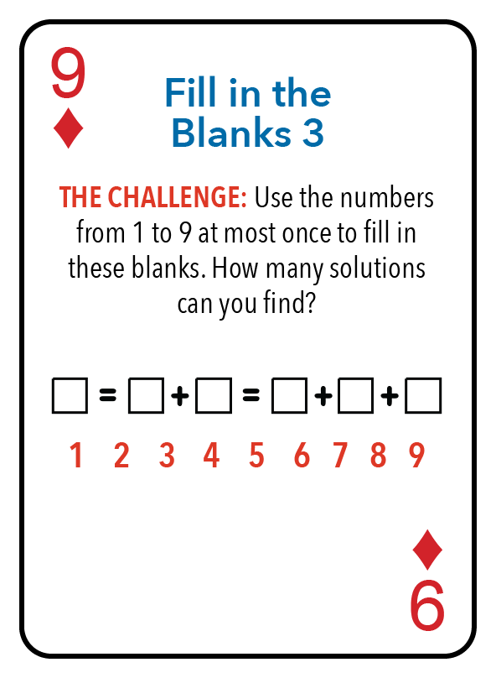
Hints:
The smallest the right hand sum can be is 6.
6 = 1 + 2 + 3 cannot work with the middle sum.
7 = 1 + 2 + 4 cannot work with the middle sum.
8 = 1 + 2 + 5 cannot work with the middle sum.
There are a total of four solutions.
Puzzle – 9 Diamonds

Slide 38
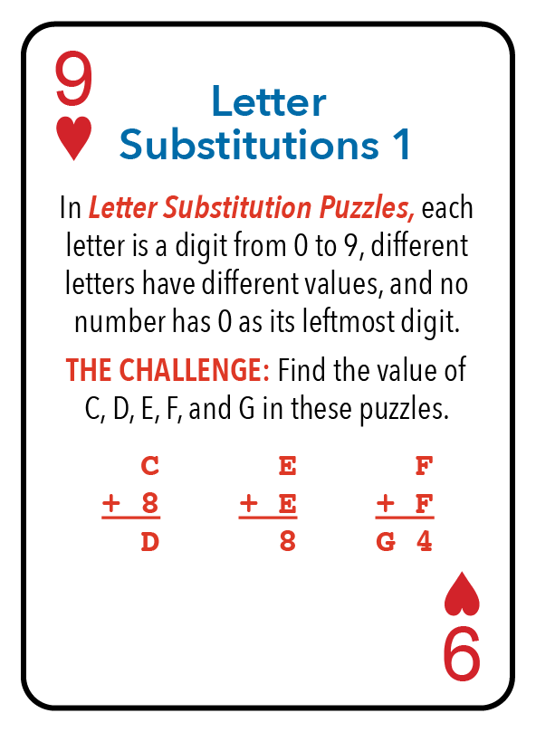
Hints:
C + 8 cannot be more than 9.
F + F must be 14.
Puzzle – 9 Hearts

Slide 39
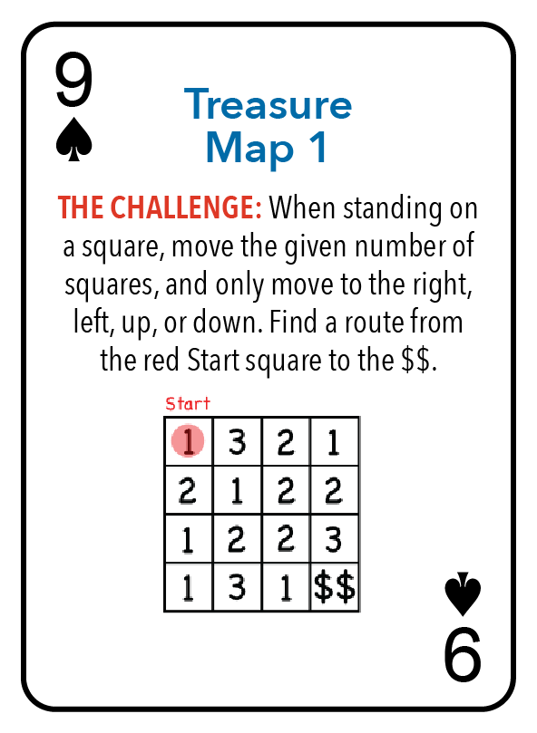
Hints:
Going from the Start to the 3 does not work.
Is there more than one solution?
Puzzle – 9 Spades

Slide 40
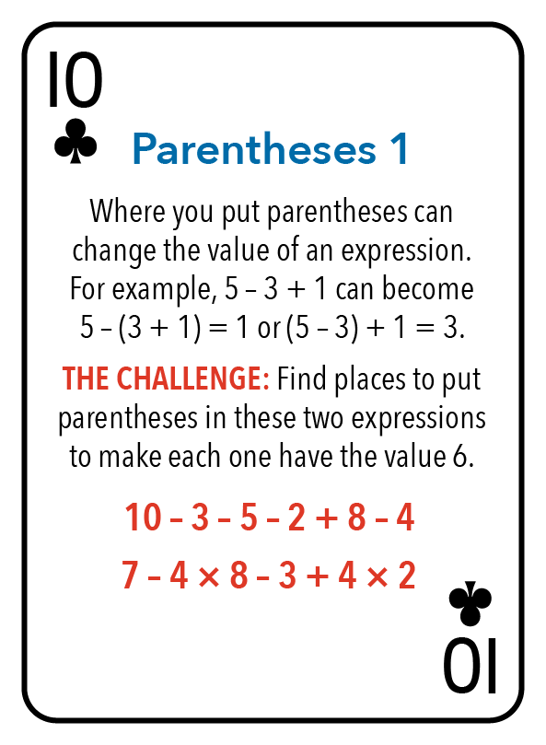
Hints:
For the first expression, the target value is 6, which is less than 10, and we do not need to use negative numbers.
For the second expression, one way to get 6 is to multiply 1 times 2 times 3.
Puzzle – 10 Clubs

Slide 41
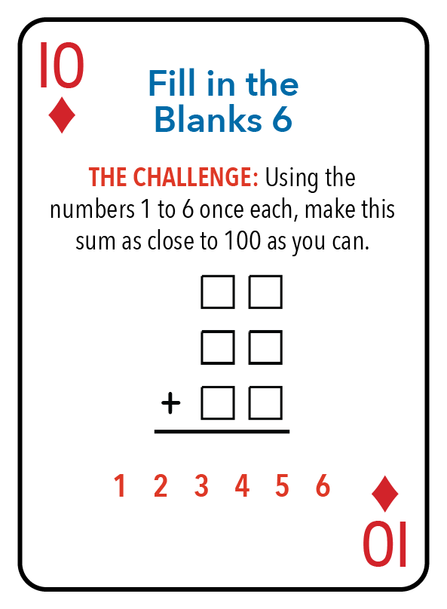
Hints:
Decide which numbers go in the ones column and which in the tens column. The pairings to create the 2-digit numbers do not matter.
The carry from the ones column will either be 0 or 1.
The numbers 1 to 6 add up to 21. If the tens column adds up to 9 or 10, the ones column will add up to 12 or 11 (respectively).
Puzzle – 10 Diamonds

Slide 42
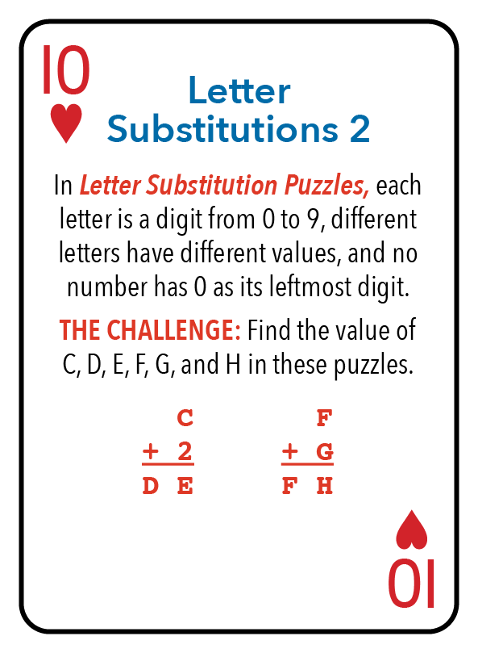
Hints:
In both puzzles, the carry into the tens place must be 1.
Puzzle – 10 Hearts

Slide 43
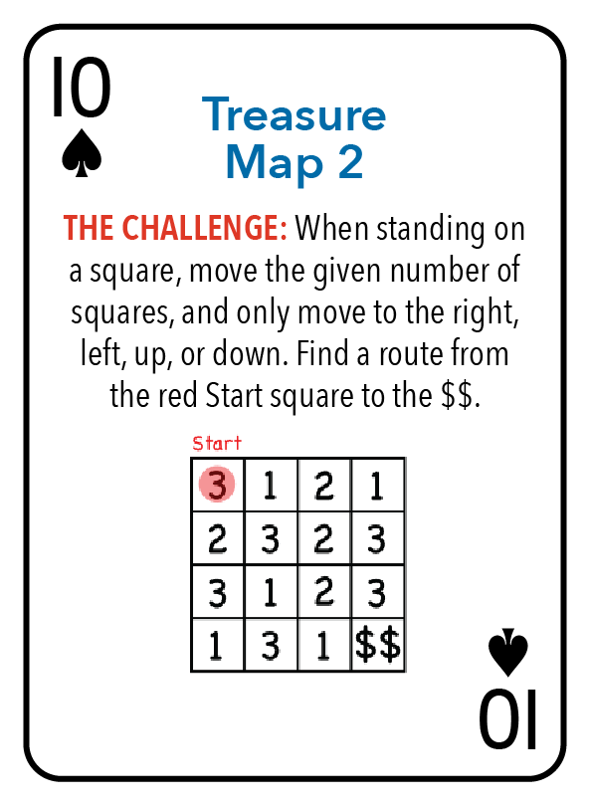
Hints:
Sometimes, going backward from the answer works better than going forward from the start. There is only one square that can go to the $$ directly.
The 1 in the middle of the bottom row is the only square that goes directly to the $$. There is only one square that can get to that 1, and there is only one square that can get to that square.
Puzzle – 10 Spades

Slide 44
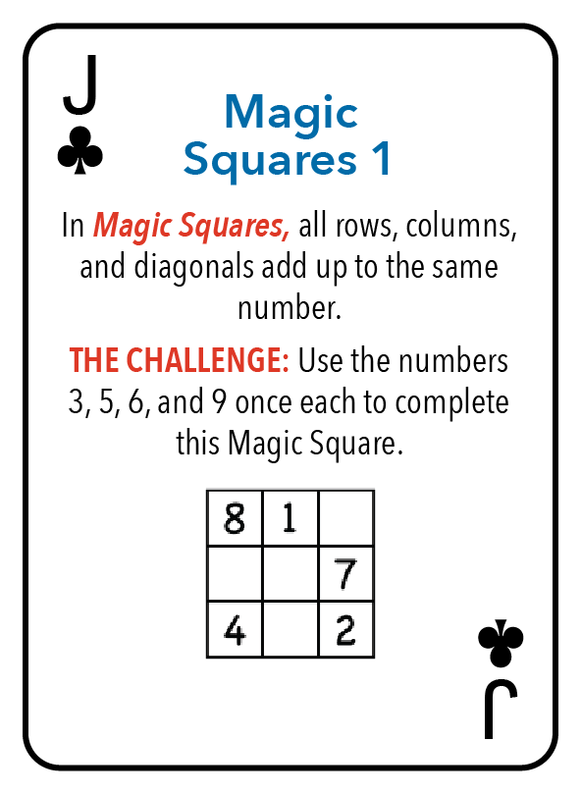
Hints:
Compare the top row with the diagonal starting in the upper left. 8 + 1 + (top right corner) is equal to 8 + 2 + (middle). So the middle must be one less than the top right corner.
Puzzle – J Clubs

Slide 45
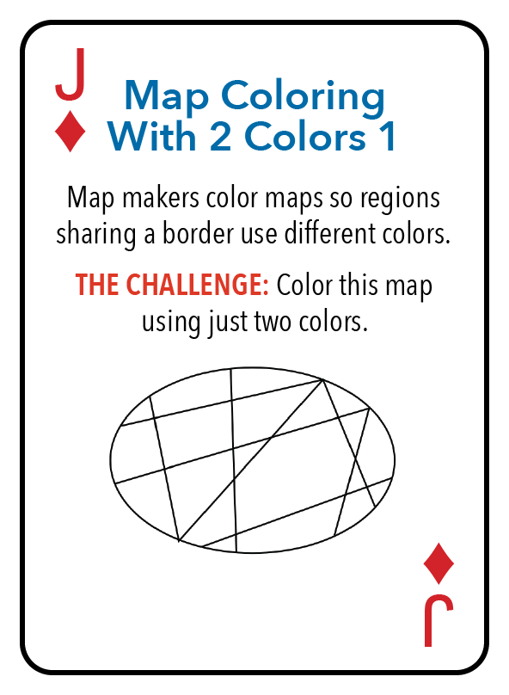
Hints:
Don’t jump around the diagram. Start at one region and work from there.
Puzzle – J Diamonds

Slide 46
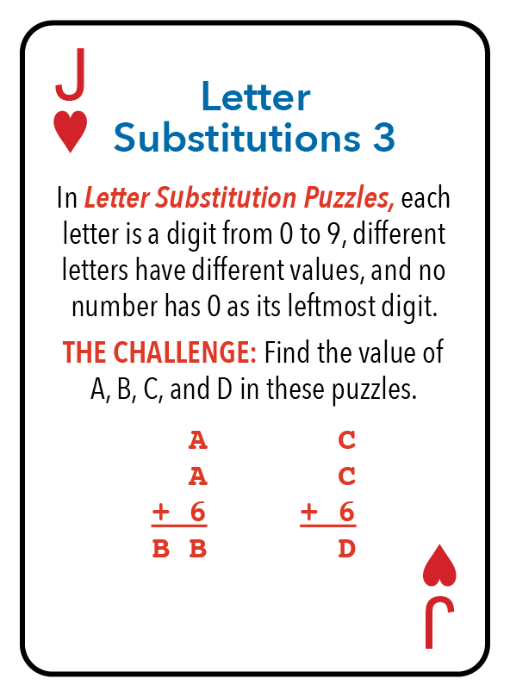
Hints:
In the leftmost puzzle, the carry is either 1 or 2. In the rightmost puzzle, the carry is 0.
Puzzle – J Hearts

Slide 47
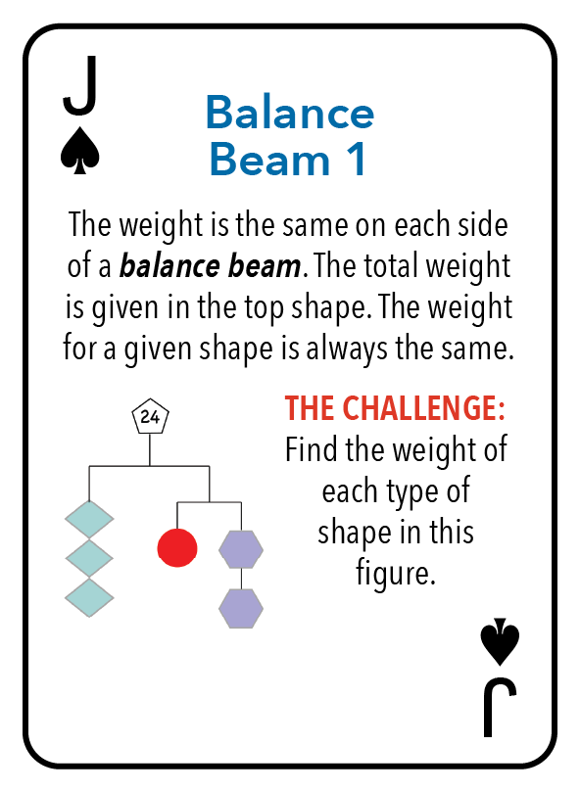
Hints:
The two sides under the 24 are evenly balanced, so each side is 12.
Puzzle – J Spades

Slide 48
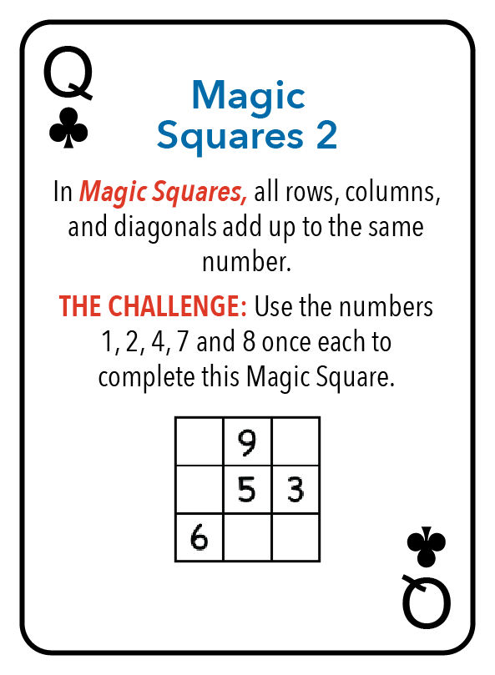
Hints:
The three rows will involve all the numbers from 1 to 9, so they will add up to 45. The three rows have the same sum, so the common sum must be 15.
Puzzle – Q Clubs

Slide 49
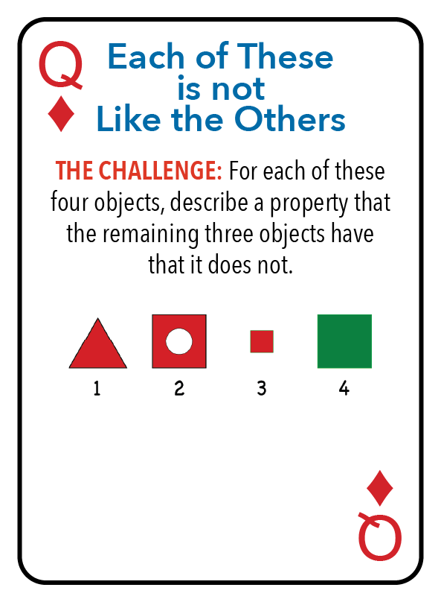
Hints:
There are shapes, sizes, and colors to use in your descriptions.
Puzzle – Q Diamonds

Slide 50
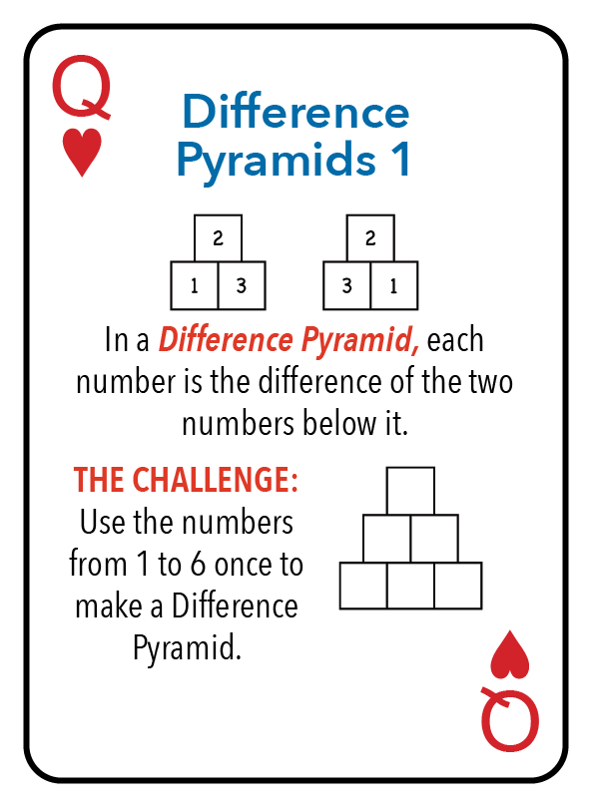
Hints:
The 6 cannot be the difference of any of these numbers, so it must be in the bottom row.
The 5 is either above the 1 and 6, or it is in the bottom row.
Can you find more than one solution?
Puzzle – Q Hearts

Slide 51
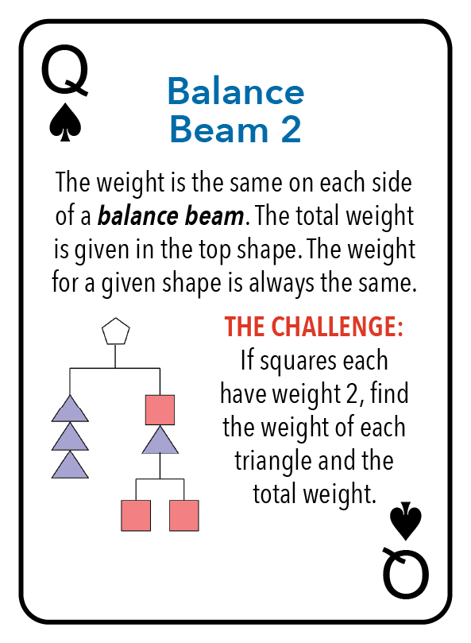
Hints:
The squares on the left side add up to 6.
The sum of 6 plus the triangle on the right balances with the three triangles on the left.
Puzzle – Q Spades

Slide 52
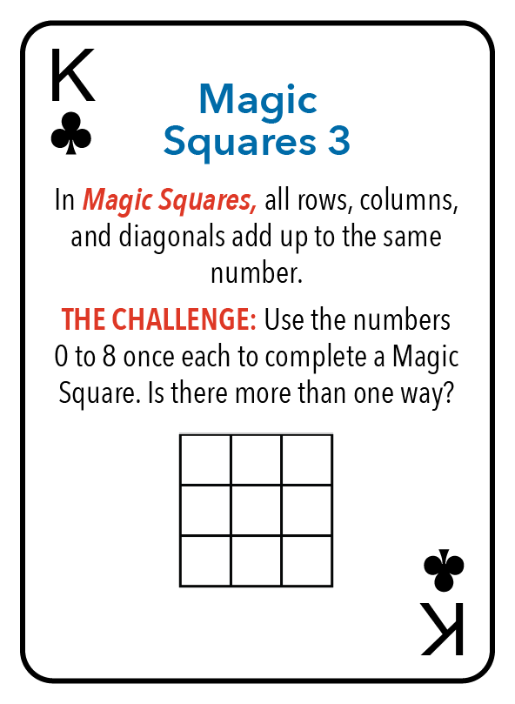
Hints:
The three rows will involve all the numbers from 0 to 8, so they will add up to 36. The three rows have the same sum, so the common sum must be 12.
There are four lines that go through the center. If you add up the four lines, that will be four 12’s which is 48. Those four lines contain all the numbers 0 to 8 once, plus the center square three extra times. The numbers from 0 to 8 add up to 36. So, 48 = 36 + 3 (center). So the center square is 4.
Puzzle – K Clubs

Slide 53
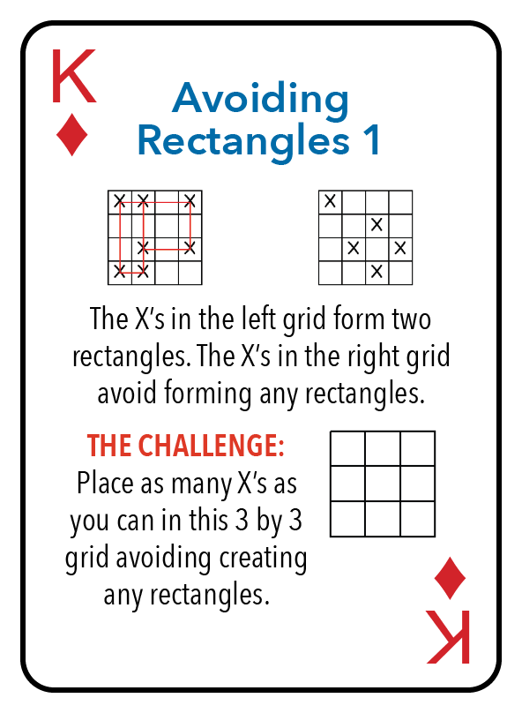
Hints:
A tempting first stab is to put five X’s along the top row and the left side. However, it is possible to put six X’s in this grid.
If there are three X’s in any row or column, you won’t be able to put more than a total of five X’s.
Puzzle – K Diamonds

Slide 54

Hints:
The 10 cannot be the difference of any of these numbers, so it must be in the bottom row.
The 9 is either above the 1 and 10, or it is in the bottom row.
Looking where 7 and 8 will go helps a lot. Though not obvious, it turns out that 8 must be in the bottom row.
Can you find more than one solution?
Puzzle – K Hearts

Slide 55

Hints:
Be organized! There are five possibilities for placing the numbers 1 to 4: (1 2 4) - (3); (1 2) - (3 4); (1 3) - (2 4); (1 4) - (2 3); and (1) - (2 3 4).
Is there more than one best solution?
Puzzle – K Spades

Slide 56


Slide 57


Slide 58


Slide 59


